Slide 1
Mapping

Slide 2
Module Overview
In this Module, we will understand the following:
What is Mapping
Persistent Class
Mapping Files
Mapping Types
OIR Mappings

Slide 3
Mapping
In case of hibernate mapping associations, 1 & only 1 of the participating classes is called as managing the relationship.
Another is called managed by using ‘mappedBy’ property.
Java objects can be identifies by hibernate as persistent when annotated with specific annotations; or else they are identified as simple plain java objects with no direct relation to database.
The JPA annotations & persistent entities when used, can lead to a situation where 2 entities can be related & should be referenced from one another, in uni-direction or in bi-direction.
Entities can be referenced to each other, directly or indirectly using an embedded property or using a collection of arrays, sets, lists, etc.
foreign key relationships are used for associations.
The association is unidirectional if only 1 of the entity pair contains a reference to another.
In case of Mutual association it is bidirectional.

Slide 4
Persistent Class
These are java classes whose objects are stored in database. These classes are known as the Plain Old Java Object (POJO) programming model if they follow rules.
They implement the entities of the business problem (e.g. Customer and Order in an E-commerce application). Not all instances of a persistent class are in the persistent state.
- Instead of being transient, an instance can be detached also
values from Java class attributes is taken and then stored to a database. Hibernate determines using mapping table on how to retrieve the classes values & do necessary mapping to tables & fields.
Notes:
@Entity:
Contained persistent package. It provide at least one no argumented Constructor.
Syntax:
@Entity public class Employee implements Serializable { }
@Table
Details of employee or student that persist database. Use the schema and enforce constraints of column.
Syntax:
@Table(name = "employee")
@Column
Name attribute of this annotation is used for specifying the table’s column name.
Syntax:
@Column(name = "employee_name")
@Id
specifies the primary key of the entity.
Syntax:
@Id
@Column(name = "id")
@Transient
Syntax:
@Transient
Private int employeePhone;

Slide 5
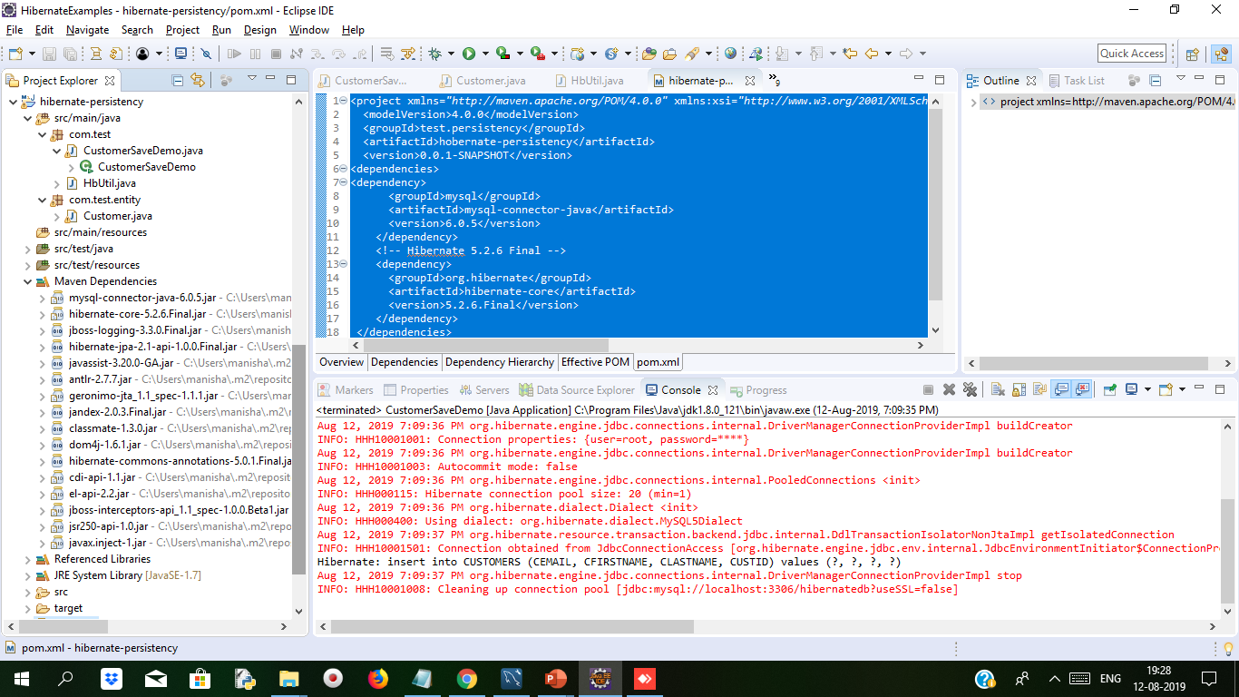
Demo: Persistent Cont..
Create Maven Project . The structure is as below
In this example we will create Customer.java class whose object will store in the database table
We created com.test package which has CustomerSaveDemo.java file and HbUtil.java file and com.test.entity package will have Customer.java file

Slide 6
Demo: Persistent Cont..
Adding dependency to project in Pom.xml
<project xmlns="http://maven.apache.org/POM/4.0.0" xmlns:xsi="http://www.w3.org/2001/XMLSchema-instance" xsi:schemaLocation="http://maven.apache.org/POM/4.0.0 http://maven.apache.org/xsd/maven-4.0.0.xsd">
<modelVersion>4.0.0</modelVersion>
<groupId>test.persistency</groupId>
<artifactId>hobernate-persistency</artifactId>
<version>0.0.1-SNAPSHOT</version>
<dependencies>
<dependency>
<groupId>mysql</groupId>
<artifactId>mysql-connector-java</artifactId>
<version>6.0.5</version>
</dependency>
<!-- Hibernate 5.2.6 Final -->
<dependency>
<groupId>org.hibernate</groupId>
<artifactId>hibernate-core</artifactId>
<version>5.2.6.Final</version>
</dependency>
</dependencies>
</project>

Slide 7
Demo: Persistent Cont..
Customer.java Persistence Class
package com.test.entity;
import java.util.Date;
import javax.persistence.Column;
import javax.persistence.Entity;
import javax.persistence.Id;
import javax.persistence.Table;
@Entity
@Table(name="CUSTOMERS")
public class Customer {
@Id
@Column(name="CUSTID")
private int id;
@Column(name="CFIRSTNAME")
private String firstName;
@Column(name="CLASTNAME")
private String lastName;
@Column(name="CEMAIL")
private String email;
public void setId(int id) {
this.id = id;
}
public int getId() {
return id;
}
public void setFirstName(String firstName) {
this.firstName = firstName;
}
public String getFirstName() {
return firstName;
}
public void setLastName(String lastName) {
this.lastName = lastName;
}
public String getLastName() {
return lastName;
}
public void setEmail(String email)
{
this.email=email;
}
public String getEmail() {
return email;
}
}

Slide 8
Demo: Persistent Cont..
settings.put("hibernate.dialect","org.hibernate.dialect.MySQL5Dialect");
registryBuilder.applySettings(settings);
registry = registryBuilder.build();
MetadataSources sources = new MetadataSources(registry)
.addAnnotatedClass(Customer.class);
Metadata metadata = sources.getMetadataBuilder().build();
sessionFactory = metadata.getSessionFactoryBuilder().build();
} catch (Exception e) {
System.out.println("SessionFactory creation failed");
if (registry != null) {
StandardServiceRegistryBuilder.destroy(registry);
}
}
}
return sessionFactory;
}
public static void shutdown() {
if (registry != null) {
StandardServiceRegistryBuilder.destroy(registry);
}
}
}
HbUtil.java file for configuring database connection
package com.test;
import java.util.HashMap;
import java.util.Map;
import org.hibernate.SessionFactory;
import org.hibernate.boot.Metadata;
import org.hibernate.boot.MetadataSources;
import org.hibernate.boot.registry.StandardServiceRegistry;
import org.hibernate.boot.registry.StandardServiceRegistryBuilder;
import com.test.entity.Customer;
public class HbUtil {
private static StandardServiceRegistry registry;
private static SessionFactory sessionFactory;
public static SessionFactory getSessionFactory() {
if (sessionFactory == null) {
try {
StandardServiceRegistryBuilder registryBuilder =
new StandardServiceRegistryBuilder();
Map<String, String> settings = new HashMap<>();
settings.put("hibernate.connection.driver_class", "com.mysql.cj.jdbc.Driver");
settings.put("hibernate.connection.url", "jdbc:mysql://localhost:3306/hibernatedb?useSSL=false");
settings.put("hibernate.connection.username", "root");
settings.put("hibernate.connection.password", "root");
settings.put("hibernate.show_sql", "true");
settings.put("hibernate.hbm2ddl.auto", "update");

Slide 9
Demo: Persistent Cont..
CustomerSaveDemo.java file for starting the transaction through persistence class customer
package com.test;
import java.util.Calendar;
import org.hibernate.Session;
import org.hibernate.Transaction;
import com.test.entity.Customer;
public class CustomerSaveDemo {
public static void main(String[] args) {
// TODO Auto-generated method stub
Session session = null;
Transaction transaction = null;
try {
session = HbUtil.getSessionFactory().openSession();
transaction=session.getTransaction();
if(!transaction.isActive())
transaction.begin();
Customer customer = new Customer();
customer.setId(17);
customer.setFirstName("Nisha");
customer.setLastName("Rastogi");
customer.setEmail("rNisha@gmail.com");
session.save(customer);
transaction.commit();
} catch (Exception e) {
if (transaction != null) {
transaction.rollback();
}
e.printStackTrace();
} finally {
if (session != null) {
session.close();
}
}
HbUtil.shutdown();
}
}

Slide 10
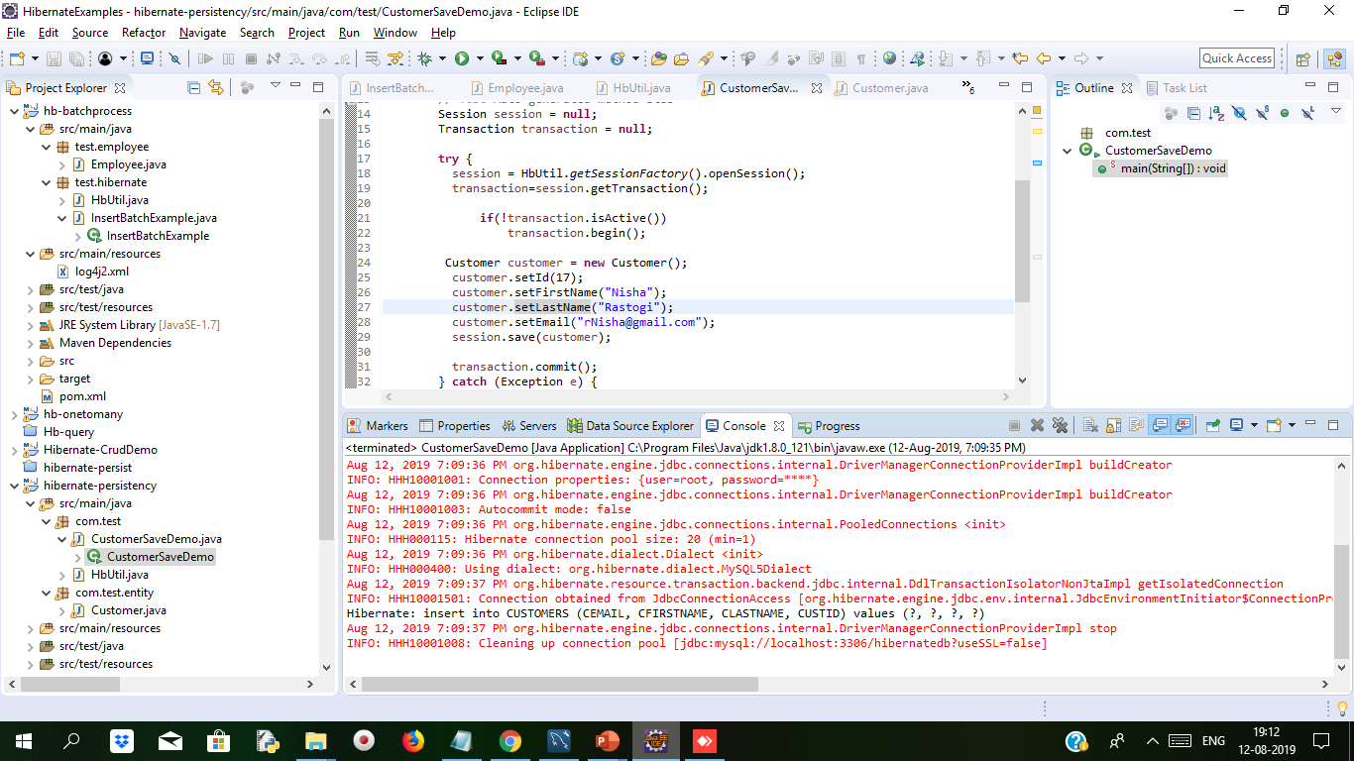
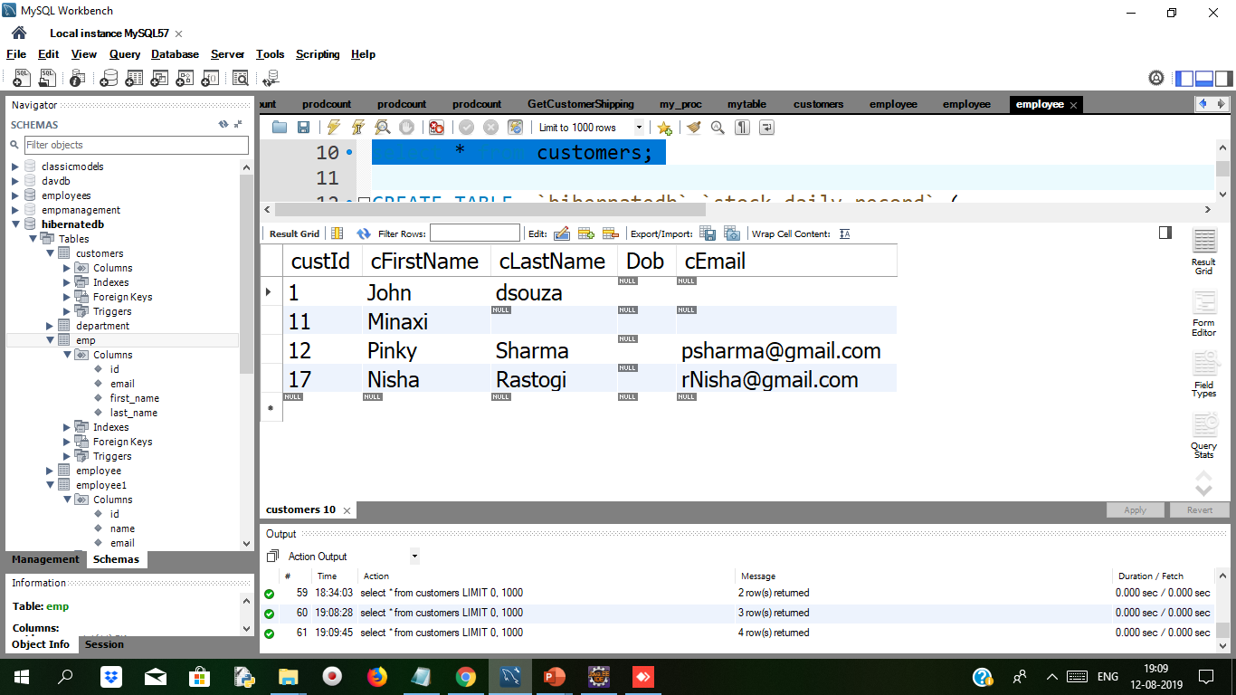
Demo: Persistent Cont..
After running the CustomerSaveDemo we get following output
Open mysql workbench we get values inserted in the customer table

Slide 11
Mapping Files
Mapping and Configuration are very familiar keywords we used to here in the hibernate, every hibernate program must need these 2 xml files.
Object/relational mappings are usually defined in an XML document. The mapping document is designed to be readable and hand-editable. The mapping language is Java-centric, meaning that mappings are constructed around persistent class declarations and not table declarations.
Primary key Auto - Generation in
Generating Primary Key automatically.
Example
If You have database table name of Student Which has two Column
Roll_No
Name
Now In This table we have define Roll_No As Primary key
There is two Ways To Define Primary Key
Define Values of All Field
Only Give Name And Primary Key Generated Automatically.
In Hibernate Prove Unique Number called Primary Key.
Notes:
Refer: https://docs.jboss.org/hibernate/core/3.3/reference/en/html/mapping.html

Slide 12
Mapping Files Cont..
How To Generate Primary Key Value
Hibernate Generate Automatically value of primary key.
For Automatically primary key Hibernate used @GeneratedValue Annotation.
Syntax:
@Id @GeneratedValue(Strategy = GenerationType.AUTO)
Private int rollNo;
Strategy For GeneratedValue Annotation:
AUTO
IDENTITY
SEQUENCE
TABLE
Notes:
@GeneratedValue defines how to generate value for the given column. GenerationType.AUTO sets @GeneratedValue automatic.
If table has defined any default value or it has defined any auto increment in table then in that case we use
@GeneratedValue(strategy=GenerationType.AUTO)

Slide 13
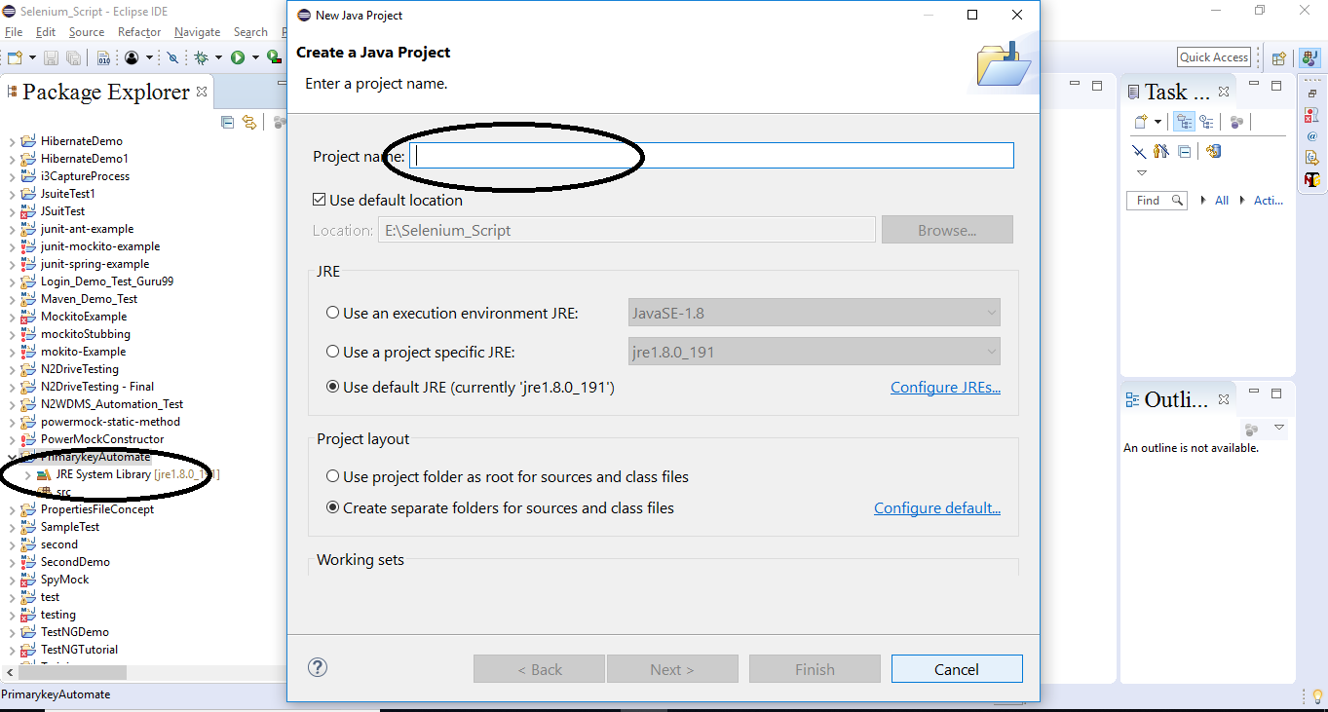
Demo: Mapping File Duration 10 min
Step 1: Example
Create New Java Maven Project and Give Artificial Id and Group Id

Slide 14
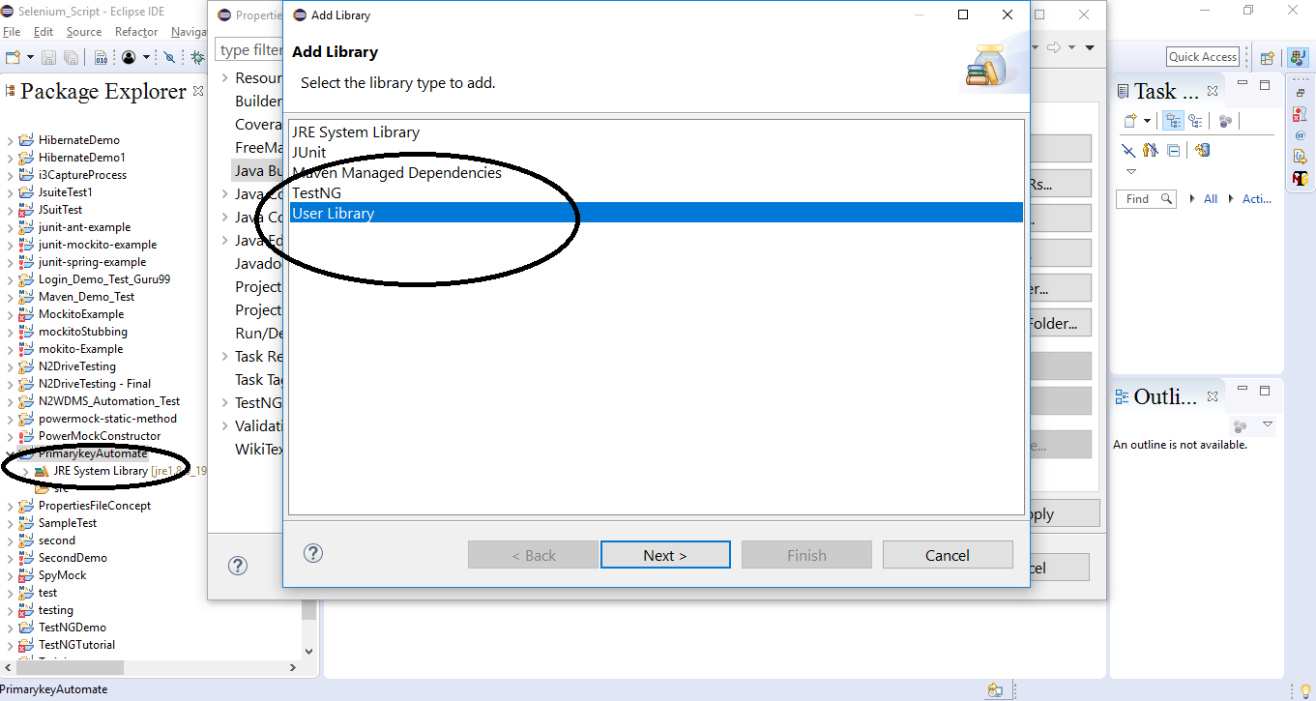
Demo: Mapping File Cont..
Step 2:
Add User Library

Slide 15
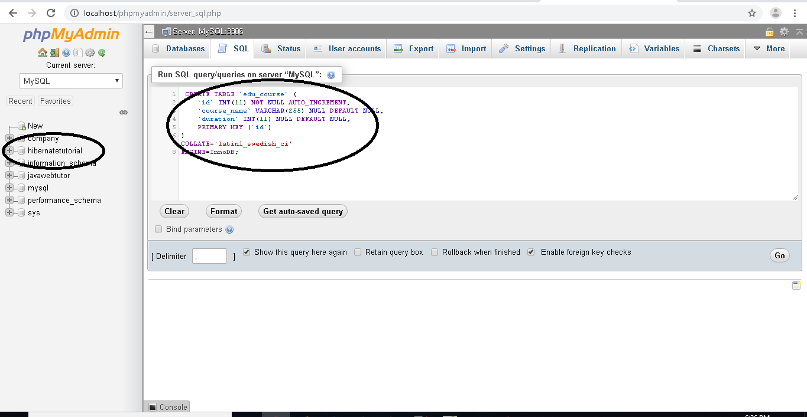
Demo: Mapping File Cont..
Step 3:
Create Database and table

Slide 16
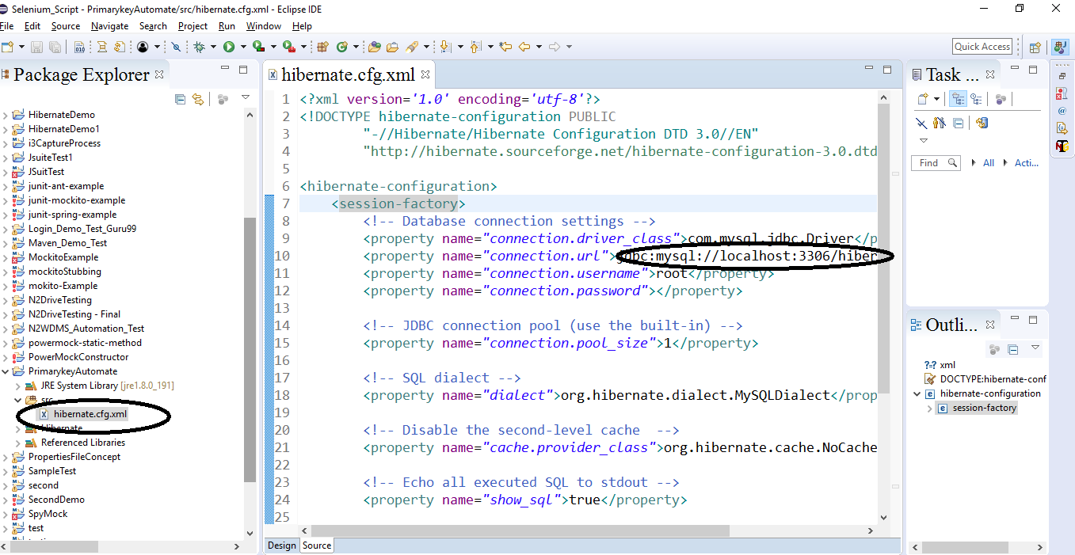
Demo: Mapping File Cont..
Step 4:
Configure hbm.config.xml file with new database name

Slide 17
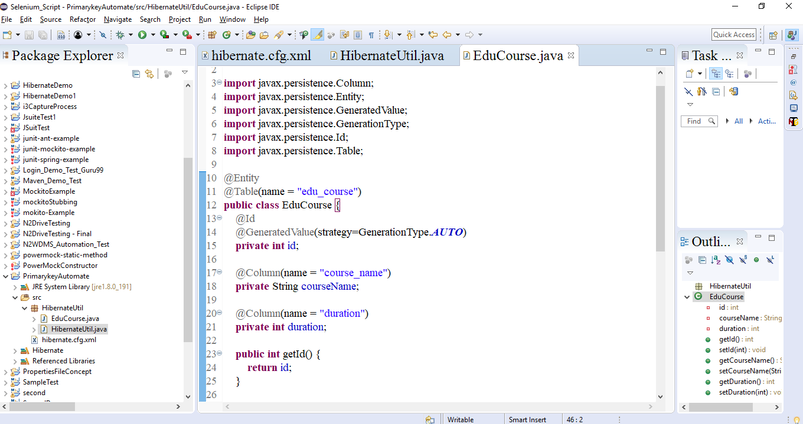
Demo: Mapping File Cont..
Step 5:
Using Annotations create pojo

Slide 18
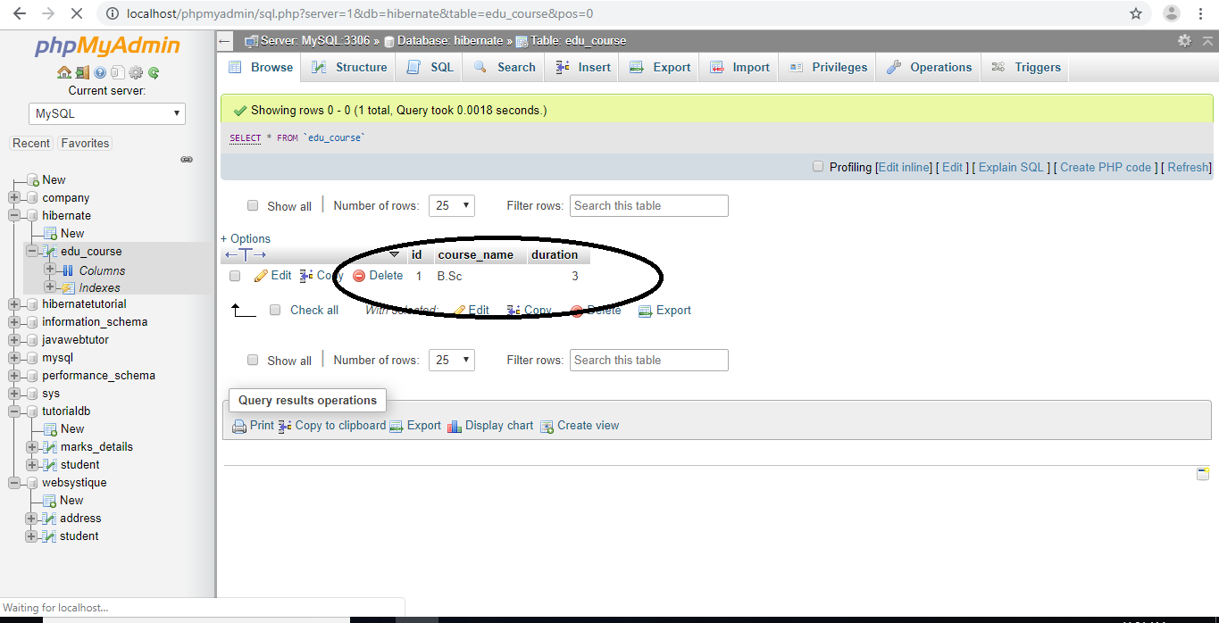
Demo: Mapping File Cont..
Step 6:
Output

Slide 19
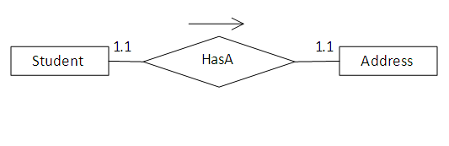
One to One Mapping using Annotations
Mapping Types
Database Table Associated many forms:
One-to-one
One-to-many
Many-to-many
This Association divided in XML Configuration and Annotation.
Example
Notes:
According to the relationship each student should have a unique address.
To create this relationship you need to have a STUDENT and ADDRESS table. The relational model is shown below.
Syntax:
@OneToOne
@PrimaryKeyJoinColumn
private Customer customer;
public CustomerDetails() {
}

Slide 20
Demo: Mapping Types One to One Cont..
CREATE TABLE EMPLOYEES
(
RECORD_ID INT NOT NULL AUTO_INCREMENT,
AGE INT,
NAME VARCHAR(255),
PRIMARY KEY (RECORD_ID)
)
ENGINE=InnoDB;
CREATE TABLE PHONESIM
(
RECORD_ID INT NOT NULL AUTO_INCREMENT,
NAME VARCHAR(255),
EMP_ID INT,
PRIMARY KEY (RECORD_ID)
)
ENGINE=InnoDB;
ALTER TABLE PHONESIM
ADD CONSTRAINT FK_28498m2ap6ybm5xn8tce6iwmh FOREIGN KEY (EMP_ID)
REFERENCES EMPLOYEES (RECORD_ID)

Slide 21
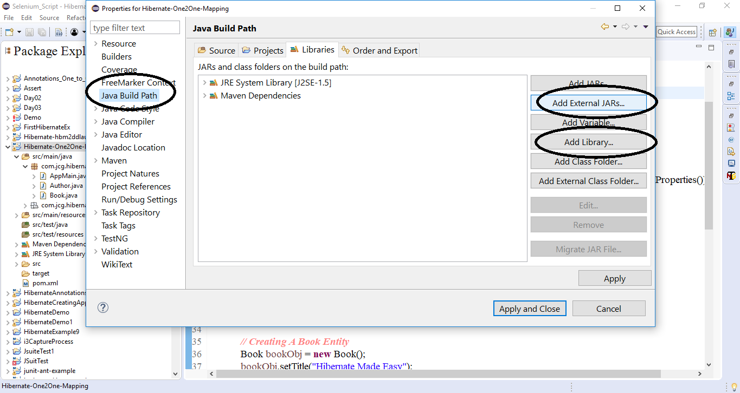
Demo: Mapping Types Cont..
Step 3:
Add Hibernate User Library

Slide 22
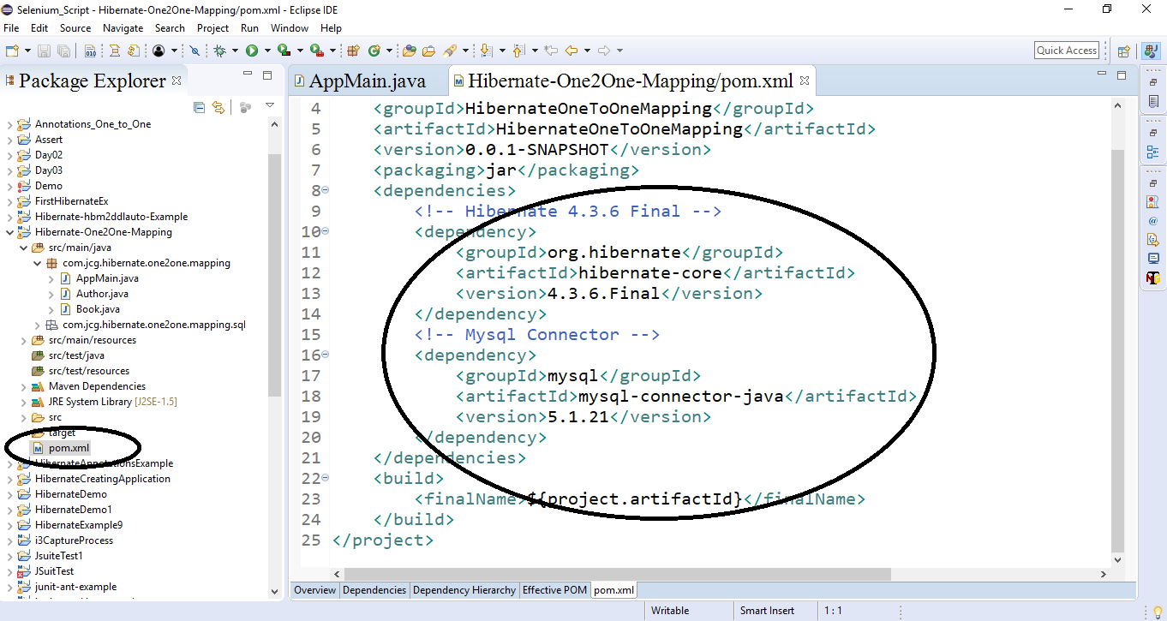
Demo: Mapping Types Cont..
Step 4:
Add Dependency In POM.XML File

Slide 23
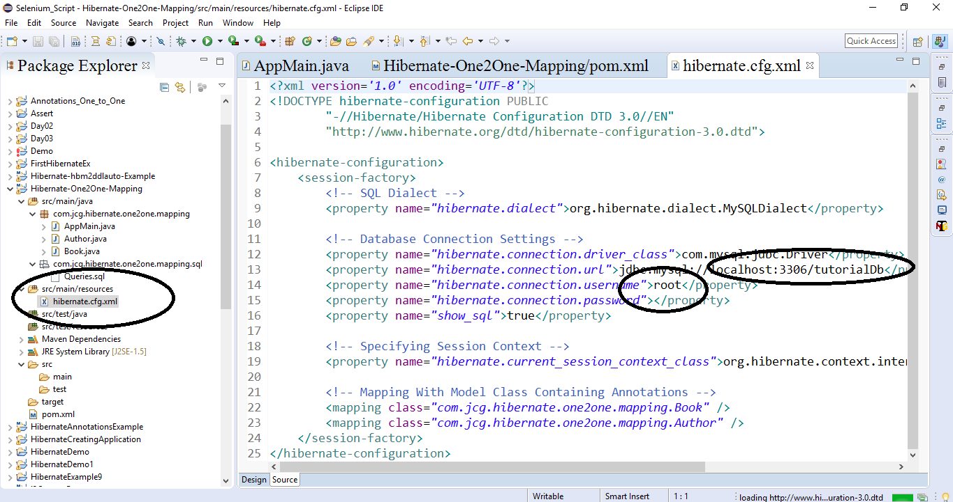
Demo: Mapping Types Cont..
Step 5:
Configure hbm.xml file and give your database name

Slide 24
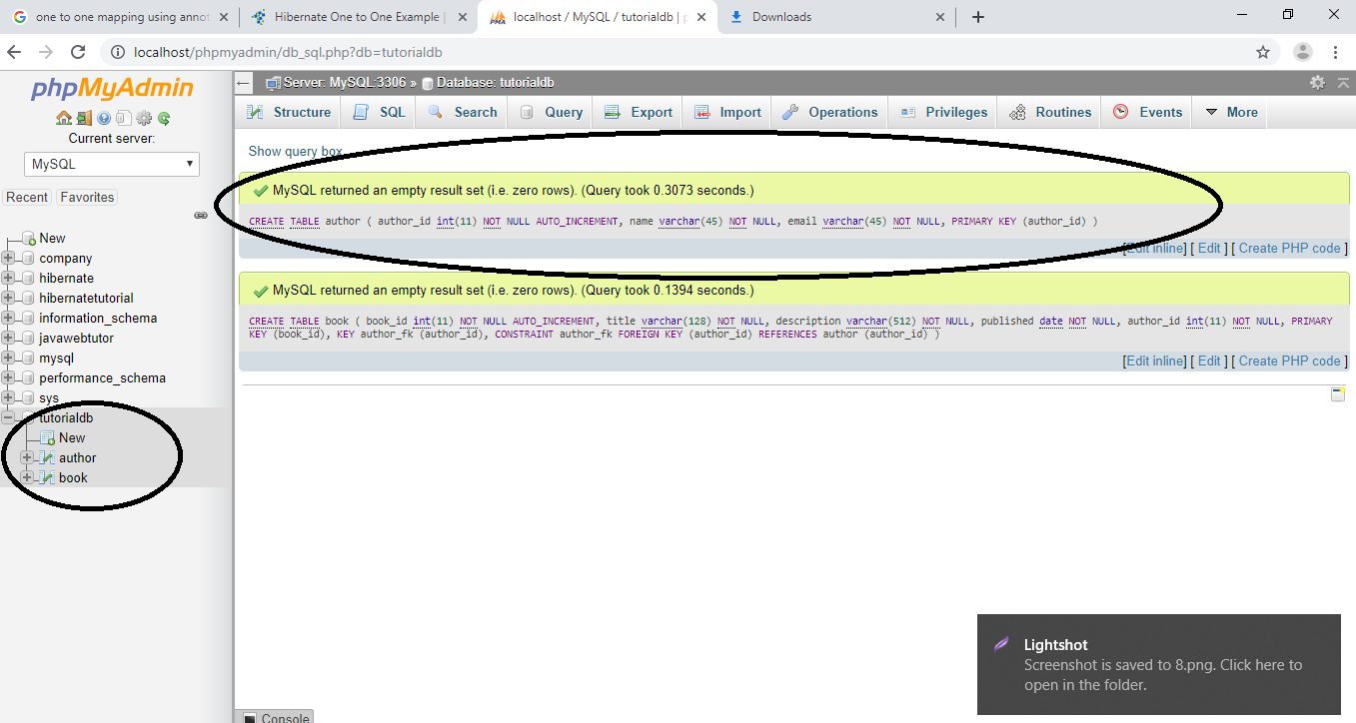
Demo: Mapping Types Cont..
Step 6:
Create Database and table with suitable name

Slide 25
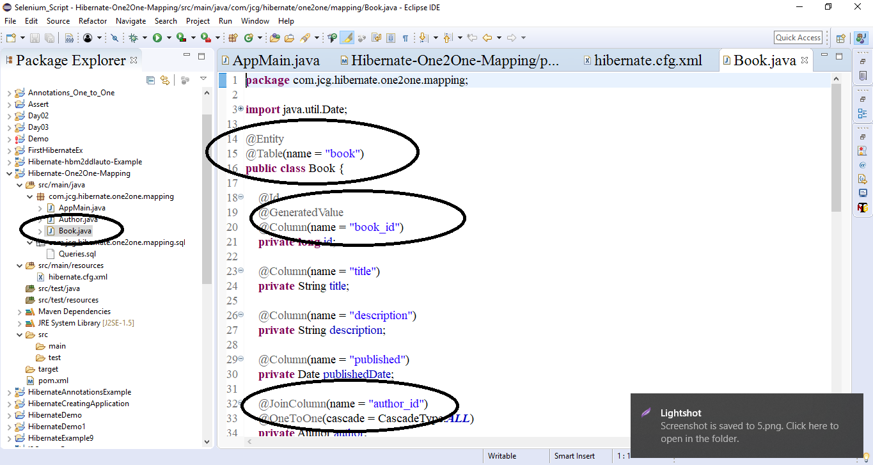
Demo: Mapping Types Cont..
Step 7:
Create POJO of table using annotation

Slide 26
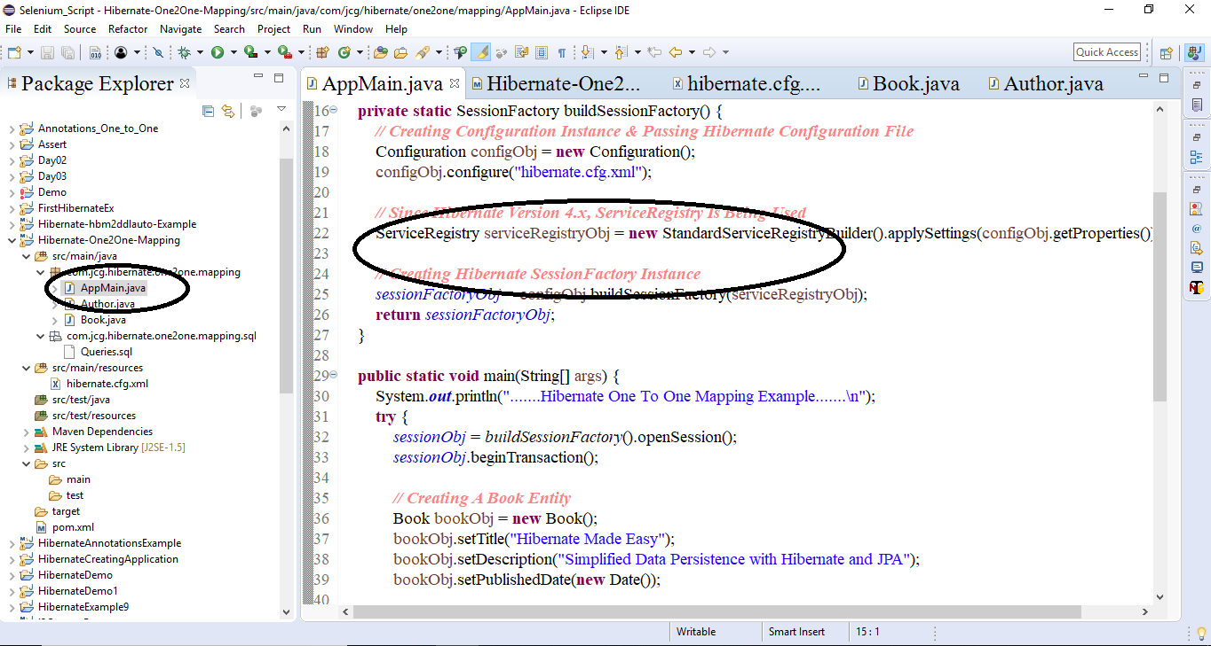
Demo: Mapping Types Cont..
Step 8:
Create main Class

Slide 27
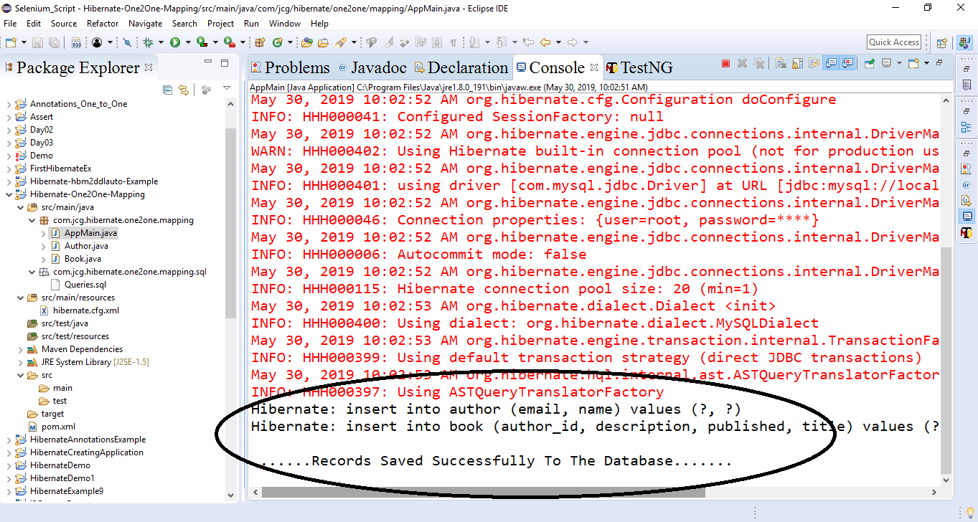
Demo: Mapping Types Cont..
Step 9:
Output

Slide 28
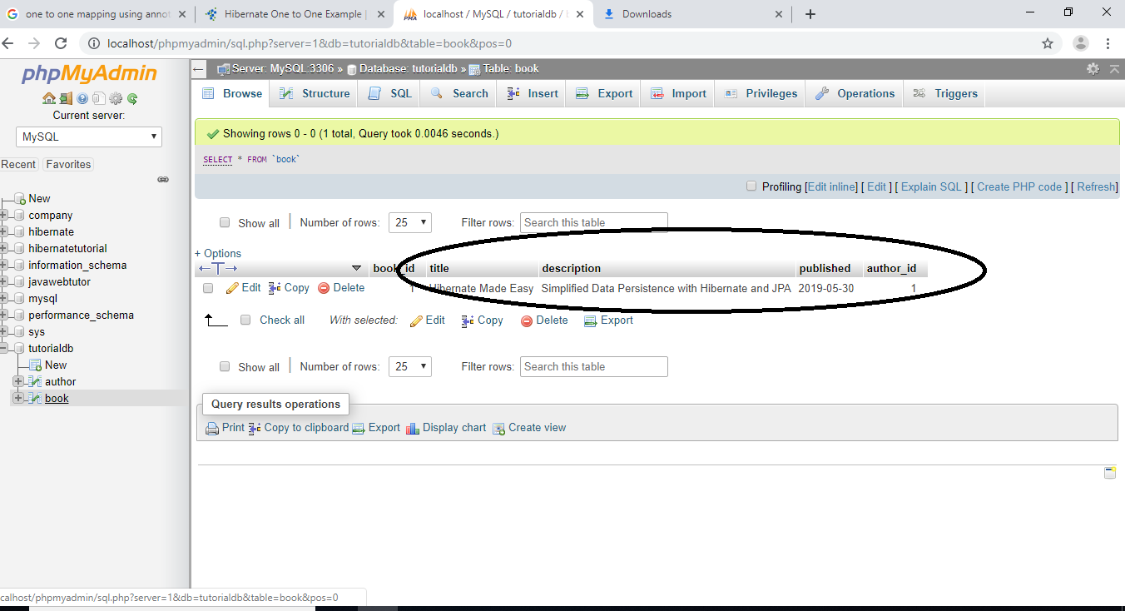
Demo: Mapping Types Cont..
Step 10:
Database record

Slide 29
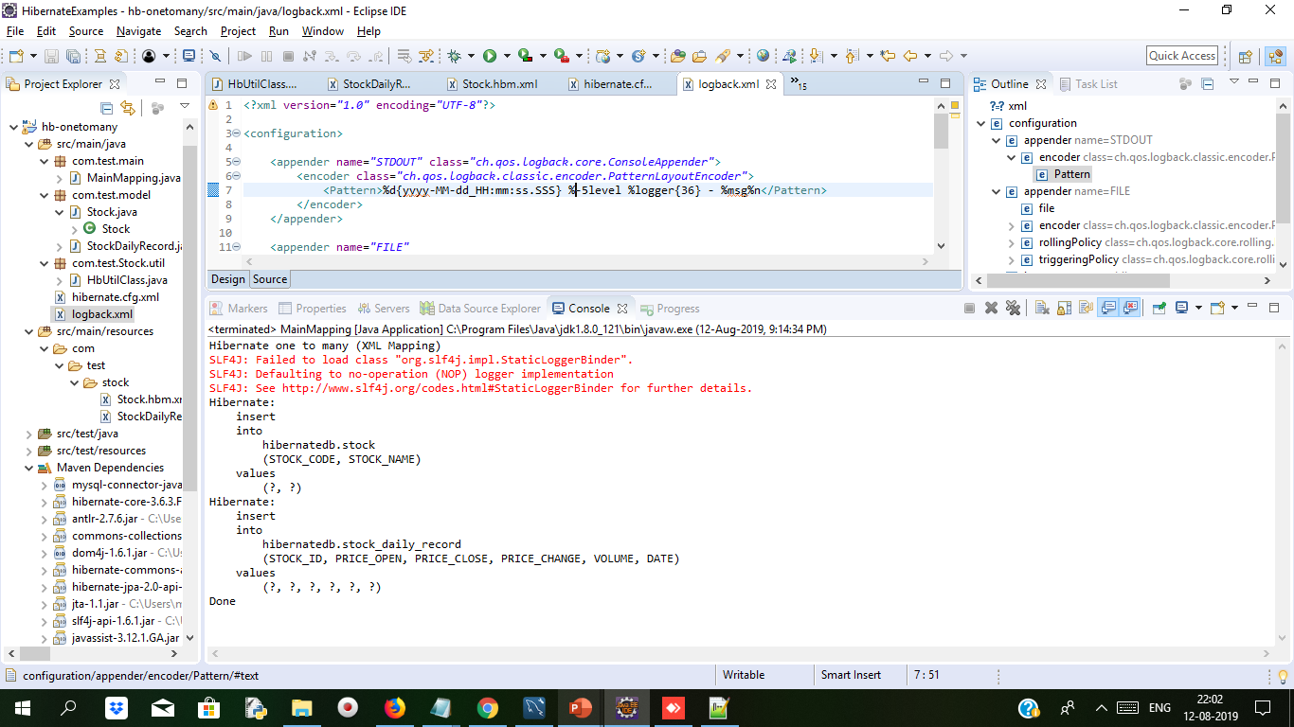
Bidrectional One to Many and many to one Mapping Example Duration 15 min
Create maven Project

Slide 30
Many to one Mapping Example Duration 15 min
Open mysql workbench and type below script in query tab for creating tables
CREATE TABLE `hibernatedb`.`stock_daily_record` (
`RECORD_ID` int(10) unsigned NOT NULL AUTO_INCREMENT,
`PRICE_OPEN` float(6,2) DEFAULT NULL,
`PRICE_CLOSE` float(6,2) DEFAULT NULL,
`PRICE_CHANGE` float(6,2) DEFAULT NULL,
`VOLUME` bigint(20) unsigned DEFAULT NULL,
`DATE` date NOT NULL,
`STOCK_ID` int(10) unsigned NOT NULL,
PRIMARY KEY (`RECORD_ID`) USING BTREE,
UNIQUE KEY `UNI_STOCK_DAILY_DATE` (`DATE`),
KEY `FK_STOCK_TRANSACTION_STOCK_ID` (`STOCK_ID`),
CONSTRAINT `FK_STOCK_TRANSACTION_STOCK_ID` FOREIGN KEY (`STOCK_ID`)
REFERENCES `stock` (`STOCK_ID`) ON DELETE CASCADE ON UPDATE CASCADE
) ENGINE=InnoDB AUTO_INCREMENT=36 DEFAULT CHARSET=utf8;

Slide 31
Bidrectional One to Many and many to one Mapping Example Duration 15 min
create stock table
CREATE TABLE `stock` (
`STOCK_ID` int(10) unsigned NOT NULL AUTO_INCREMENT,
`STOCK_CODE` varchar(10) NOT NULL,
`STOCK_NAME` varchar(20) NOT NULL,
PRIMARY KEY (`STOCK_ID`) USING BTREE,
UNIQUE KEY `UNI_STOCK_NAME` (`STOCK_NAME`),
UNIQUE KEY `UNI_STOCK_ID` (`STOCK_CODE`) USING BTREE
) ENGINE=InnoDB AUTO_INCREMENT=34 DEFAULT CHARSET=utf8;

Slide 32
Bidrectional One to Many and many to one Mapping Example Duration 15 min
Add dependency in pom.xml
<project xmlns="http://maven.apache.org/POM/4.0.0" xmlns:xsi="http://www.w3.org/2001/XMLSchema-instance" xsi:schemaLocation="http://maven.apache.org/POM/4.0.0 http://maven.apache.org/xsd/maven-4.0.0.xsd">
<modelVersion>4.0.0</modelVersion>
<groupId>OnetoManyMap</groupId>
<artifactId>hb-onetomany</artifactId>
<version>0.0.1-SNAPSHOT</version>
<repositories>
<repository>
<id>JBoss repository</id>
<url>http://repository.jboss.org/nexus/content/groups/public/</url>
</repository>
</repositories>
<dependencies>
<!-- MySQL database driver -->
<dependency>
<groupId>mysql</groupId>
<artifactId>mysql-connector-java</artifactId>
<version>5.1.15</version>
</dependency>
<dependency>
<groupId>org.hibernate</groupId>
<artifactId>hibernate-core</artifactId>
<version>3.6.3.Final</version>
</dependency>
<dependency>
<groupId>javassist</groupId>
<artifactId>javassist</artifactId>
<version>3.12.1.GA</version>
</dependency>
</dependencies>
</project>

Slide 33
Unidirectional VS Bidirectional One to Many and many to one Mapping Example Duration 15 min
Hibernate.cfg.xml for database configuration.Both the file i.e. Hibernate.cfg.xml and logback.xml should be keep in src folder
<?xml version="1.0" encoding="utf-8"?>
<!DOCTYPE hibernate-configuration PUBLIC
"-//Hibernate/Hibernate Configuration DTD 3.0//EN"
"http://www.hibernate.org/dtd/hibernate-configuration-3.0.dtd">
<hibernate-configuration>
<session-factory>
<property name="hibernate.connection.driver_class">com.mysql.jdbc.Driver</property>
<property name="hibernate.connection.url">jdbc:mysql://localhost:3306/hibernatedb</property>
<property name="hibernate.connection.username">root</property>
<property name="hibernate.connection.password">root</property>
<property name="hibernate.dialect">org.hibernate.dialect.MySQLDialect</property>
<property name="show_sql">true</property>
<property name="format_sql">true</property>
<mapping resource="com/test/stock/Stock.hbm.xml" />
<mapping resource="com/test/stock/StockDailyRecord.hbm.xml" />
</session-factory>
</hibernate-configuration>

Slide 34
Unidirectional VS Bidirectional One to Many and many to one Mapping Example Duration 15 min
Logback.xml
<?xml version="1.0" encoding="UTF-8"?>
<configuration>
<appender name="STDOUT" class="ch.qos.logback.core.ConsoleAppender">
<encoder class="ch.qos.logback.classic.encoder.PatternLayoutEncoder">
<Pattern>%d{yyyy-MM-dd_HH:mm:ss.SSS} %-5level %logger{36} - %msg%n</Pattern>
</encoder>
</appender>
<appender name="FILE"
class="ch.qos.logback.core.rolling.RollingFileAppender">
<file>c:/mkyongapp.log</file>
<encoder class="ch.qos.logback.classic.encoder.PatternLayoutEncoder">
<Pattern>%d{yyyy-MM-dd_HH:mm:ss.SSS} [%thread] %-5level %logger{36} - %msg%n</Pattern>
</encoder>
<rollingPolicy class="ch.qos.logback.core.rolling.FixedWindowRollingPolicy">
<MinIndex>1</MinIndex>
<MaxIndex>10</MaxIndex>
</rollingPolicy>
<triggeringPolicy
class="ch.qos.logback.core.rolling.SizeBasedTriggeringPolicy">
<MaxFileSize>2MB</MaxFileSize>
</triggeringPolicy>
</appender>
<logger name="org.hibernate.type" level="WARN" />
<logger name="org.hibernate" level="WARN" />
<root level="INFO">
<!-- <appender-ref ref="FILE" /> -->
<appender-ref ref="STDOUT" />
</root> </configuration>

Slide 35
Cont..
Make a folder com/test/stock under
src/main/resources/ and keep below file Stock.hbm.xml and Stock_daily_record.hbm.xml
<?xml version="1.0"?>
<!DOCTYPE hibernate-mapping PUBLIC "-//Hibernate/Hibernate Mapping DTD 3.0//EN"
"http://hibernate.sourceforge.net/hibernate-mapping-3.0.dtd">
<!-- Generated 26 April 2011 11:37:37 AM by Hibernate Tools 3.4.0.CR1 -->
<hibernate-mapping>
<class name="com.test.model.Stock" table="stock" catalog="hibernatedb">
<id name="stockId" type="java.lang.Integer">
<column name="STOCK_ID" />
<generator class="identity" />
</id>
<property name="stockCode" type="string">
<column name="STOCK_CODE" length="10" not-null="true" unique="true" />
</property>
<property name="stockName" type="string">
<column name="STOCK_NAME" length="20" not-null="true" unique="true" />
</property>
<set name="stockDailyRecords" table="stock_daily_record" inverse="true" lazy="true" fetch="select">
<key>
<column name="STOCK_ID" not-null="true" />
</key>
<one-to-many class="com.test.model.StockDailyRecord" /></set>
</class>
</hibernate-mapping>

Slide 36
Cont..
Stock_daily_record.hbm.xml
<?xml version="1.0"?>
<!DOCTYPE hibernate-mapping PUBLIC "-//Hibernate/Hibernate Mapping DTD 3.0//EN"
"http://hibernate.sourceforge.net/hibernate-mapping-3.0.dtd">
<!-- Generated 26 April 2011 11:37:37 AM by Hibernate Tools 3.4.0.CR1 -->
<hibernate-mapping>
<class name="com.test.model.StockDailyRecord" table="stock_daily_record" catalog="hibernatedb">
<id name="recordId" type="java.lang.Integer">
<column name="RECORD_ID" />
<generator class="identity" />
</id>
<many-to-one name="stock" class="com.test.model.Stock" fetch="select">
<column name="STOCK_ID" not-null="true" />
</many-to-one>
<property name="priceOpen" type="java.lang.Float">
<column name="PRICE_OPEN" precision="6" />
</property>
<property name="priceClose" type="java.lang.Float">
<column name="PRICE_CLOSE" precision="6" />
</property>
<property name="priceChange" type="java.lang.Float">
<column name="PRICE_CHANGE" precision="6" />
</property>
<property name="volume" type="java.lang.Long">
<column name="VOLUME" />
</property>
<property name="date" type="date">
<column name="DATE" length="10" not-null="true" unique="true" />
</property>
</class>
</hibernate-mapping>

Slide 37
Cont..
public Integer getRecordId() {
return this.recordId;
}
public void setRecordId(Integer recordId) {
this.recordId = recordId;
}
public Stock getStock() {
return this.stock;
}
public void setStock(Stock stock) {
this.stock = stock;
}
public Float getPriceOpen() {
return this.priceOpen;
}
public void setPriceOpen(Float priceOpen) {
this.priceOpen = priceOpen;
}
public Float getPriceClose() {
return this.priceClose;
}
public void setPriceClose(Float priceClose) {
this.priceClose = priceClose;
}
contd….
StockDailyRecord.java Persistency class
package com.test.model;
import java.util.Date;
public class StockDailyRecord {
private Integer recordId;
private Stock stock;
private Float priceOpen;
private Float priceClose;
private Float priceChange;
private Long volume;
private Date date;
public StockDailyRecord() {
}
public StockDailyRecord(Stock stock, Date date) {
this.stock = stock;
this.date = date;
}
public StockDailyRecord(Stock stock, Float priceOpen, Float priceClose,
Float priceChange, Long volume, Date date) {
this.stock = stock;
this.priceOpen = priceOpen;
this.priceClose = priceClose;
this.priceChange = priceChange;
this.volume = volume;
this.date = date;
}

Slide 38
Cont..
Stock.java persistence class
package com.test.model;
import java.util.HashSet;
import java.util.Set;
@SuppressWarnings("serial")
public class Stock implements java.io.Serializable {
private Integer stockId;
private String stockCode;
private String stockName;
private Set<StockDailyRecord> stockDailyRecords = new HashSet<StockDailyRecord>(0);
public Stock(String stockCode, String stockName) {
this.stockCode = stockCode;
this.stockName = stockName;
}
public Stock(String stockCode, String stockName,
Set<StockDailyRecord> stockDailyRecords) {
this.stockCode = stockCode;
this.stockName = stockName;
this.stockDailyRecords = stockDailyRecords;
}
public Stock() {
}
public Integer getStockId() {
return this.stockId;
} contd…
public Float getPriceChange() {
return this.priceChange;
}
public void setPriceChange(Float priceChange) {
this.priceChange = priceChange;
}
public Long getVolume() {
return this.volume;
}
public void setVolume(Long volume) {
this.volume = volume;
}
public Date getDate() {
return this.date;
}
public void setDate(Date date) {
this.date = date;
}
}

Slide 39
Cont..
public void setStockId(Integer stockId) {
this.stockId = stockId;
}
public String getStockCode() {
return this.stockCode;
}
public void setStockCode(String stockCode) {
this.stockCode = stockCode;
}
public String getStockName() {
return this.stockName;
}
public void setStockName(String stockName) {
this.stockName = stockName;
}
public Set<StockDailyRecord> getStockDailyRecords() {
return this.stockDailyRecords;
}
public void setStockDailyRecords(Set<StockDailyRecord> stockDailyRecords) {
this.stockDailyRecords = stockDailyRecords;
}
}

Slide 40
Cont..
HbUtilClass.java for making sessionfactory object
package com.test.Stock.util;
import org.hibernate.SessionFactory;
import org.hibernate.cfg.Configuration;
public class HbUtilClass {
private static final SessionFactory sessionFactory = buildSessionFactory();
private static SessionFactory buildSessionFactory() {
try {
// Create the SessionFactory from hibernate.cfg.xml
return new Configuration().configure().buildSessionFactory();
} catch (Throwable ex) {
// Make sure you log the exception, as it might be swallowed
System.err.println("Initial SessionFactory creation failed." + ex);
throw new ExceptionInInitializerError(ex);
}
}
public static SessionFactory getSessionFactory() {
return sessionFactory;
}
public static void shutdown() {
// Close caches and connection pools
getSessionFactory().close();
}
}

Slide 41
Cont..
MainMapping.java file
package com.test.main;
import java.util.Date;
import org.hibernate.Session;
import com.test.Stock.util.HbUtilClass;
import com.test.model.Stock;
import com.test.model.StockDailyRecord;
public class MainMapping {
public static void main(String[] args) {
System.out.println("Hibernate one to many (XML Mapping)");
Session session = HbUtilClass.getSessionFactory().openSession();
session.beginTransaction();
Stock stock = new Stock();
stock.setStockCode("1901");
stock.setStockName("STATIONARY");
session.save(stock);
StockDailyRecord stockDailyRecords = new StockDailyRecord();
stockDailyRecords.setPriceOpen(new Float("1.2"));
stockDailyRecords.setPriceClose(new Float("1.1"));
stockDailyRecords.setPriceChange(new Float("10.0"));
stockDailyRecords.setVolume(3000000L);
stockDailyRecords.setDate(new Date());
stockDailyRecords.setStock(stock);
stock.getStockDailyRecords().add(stockDailyRecords);
session.save(stockDailyRecords);
session.getTransaction().commit();
System.out.println("Done");
}
}

Slide 42
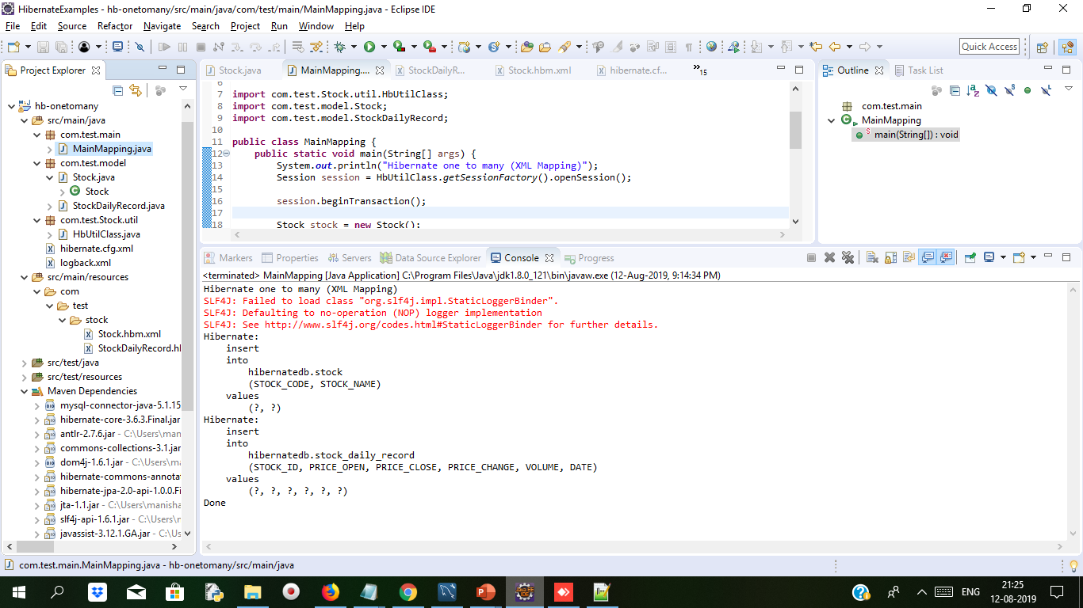
Cont..
Output on Console when we run MainMapping.java file
LogBack.xml file helps to print on console when we execute the main method.It has some pattern for displaying on console

Slide 43
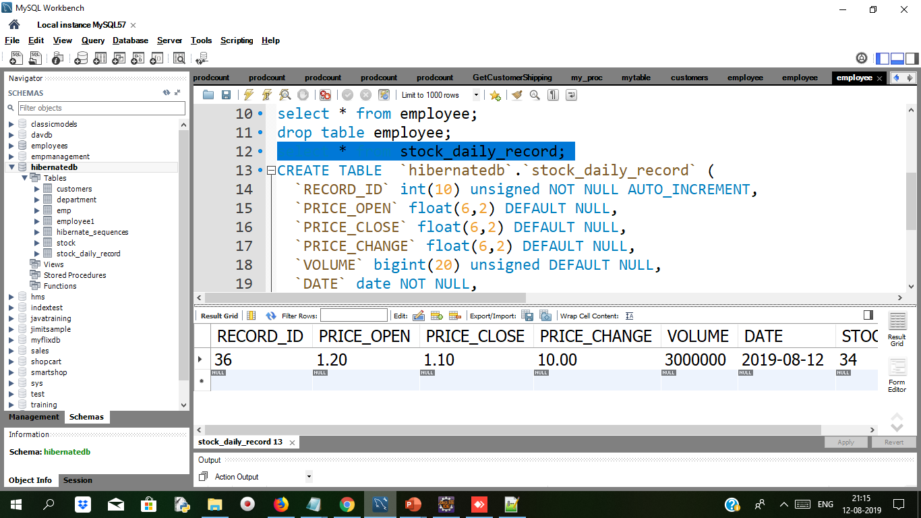
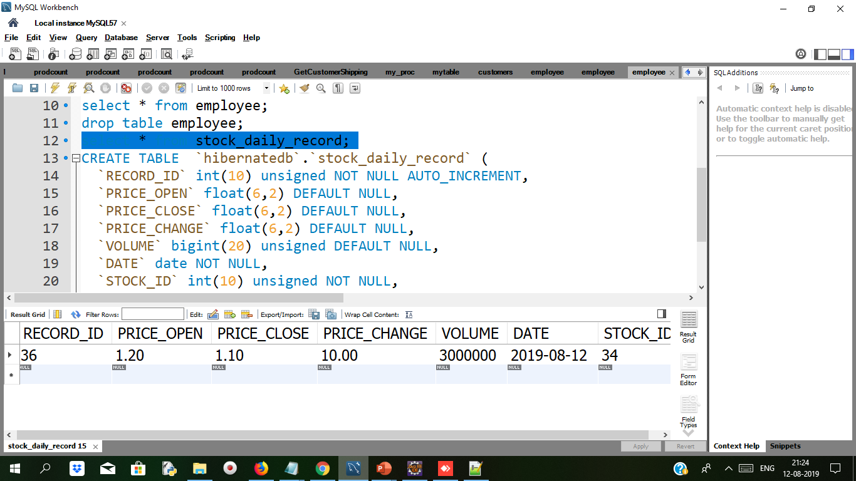
Cont..
When we run MainMapping.java file we get some rows added in Stock table and Stock_daily_record table we can check in mysql workbench with select * from Stock and select * from Stock_daily_record

Slide 44
Unidirectional VS Bidirectional
Unidirectional VS Bidirectional
When only one of the pair of entities contains a reference to the other, the association is unidirectional. | if the association between both entities are mutual, then it is known as bidirectional mapping. in bidirectional mapping
unidirectional mapping from lecturer to course class Lecturer{ private Long id; private String lecturerName; private Course; //getter and setters } class Course{ private Long id; private String courseName; //getter and setters } | The Bidirectional association: class Lecturer{ private Long id; private String lecturerName; private Course; //getter and setters } class Course{ private Long id; private String courseName; private Lecturer lecturer; //getter and setters }

Slide 45
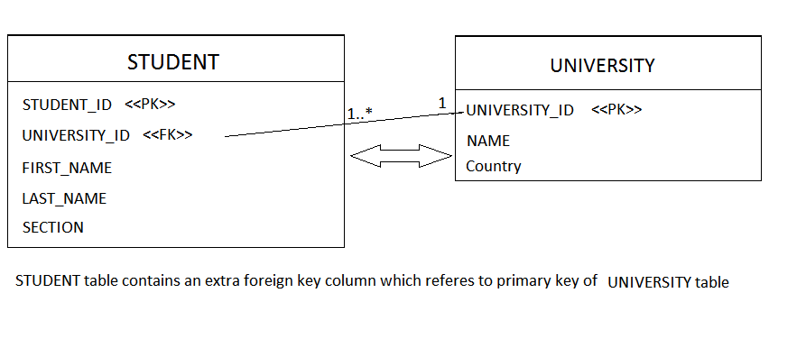
Many to One Mapping in a Hibernate Application
Many to one the relation is from child to parent object.
Many to one relation links to the two-table using foreign key.
@manytoone annotation allows mapping of Child has an entity of parent object.
Syntax:
Public class student{
//…
@oneToMany(mappedBy=“University”)
Private Set<Student_Id> ;
//…
}

Slide 46
Many to One Mapping in a Hibernate Application Cont..
-Each entity has relationship with each other
-Entity constraint Foreign key
-Also used Mapped By Property
-One table provide foreign key which give reference to another table.
Syntax:
@Entity
public class Review {
@Id
@GeneratedValue(strategy = GenerationType.AUTO)
@Column(name = “id”, updatable = false, nullable = false)
private Long id;
@ManyToOne
@JoinColumn(name = “fk_book”)
private Book book;
…
}

Slide 47
Demo: ManyToOne / OneToMany Mapping ( Bidirectional ) Duration: 15 min
Open mysqlworkbench and open script and type
CREATE DATABASE mapping;
USE mapping;
CREATE TABLE IF NOT EXISTS student (
student_id int(100) NOT NULL AUTO_INCREMENT,
first_name varchar(50) DEFAULT NULL,
last_name varchar(50) DEFAULT NULL,
email varchar(50) DEFAULT NULL,
phone varchar(50) DEFAULT NULL,
PRIMARY KEY (student_id)
);
CREATE TABLE IF NOT EXISTS marks_details (
student_id int(100) NOT NULL,
test_id int(100) NOT NULL AUTO_INCREMENT,
subject varchar(100) DEFAULT NULL,
max_marks varchar(100) DEFAULT NULL,
marks_obtained varchar(100) DEFAULT NULL,
result varchar(100) DEFAULT NULL,
PRIMARY KEY (test_id),
KEY FK_marks_details_student (student_id),
CONSTRAINT FK_marks_details_student FOREIGN KEY (student_id) REFERENCES student (student_id)
);

Slide 48
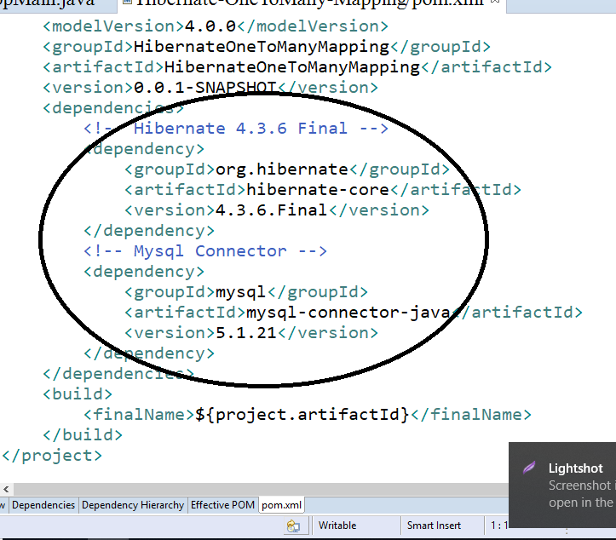
Cont..
Add Dependency in POM.XML file

Slide 49
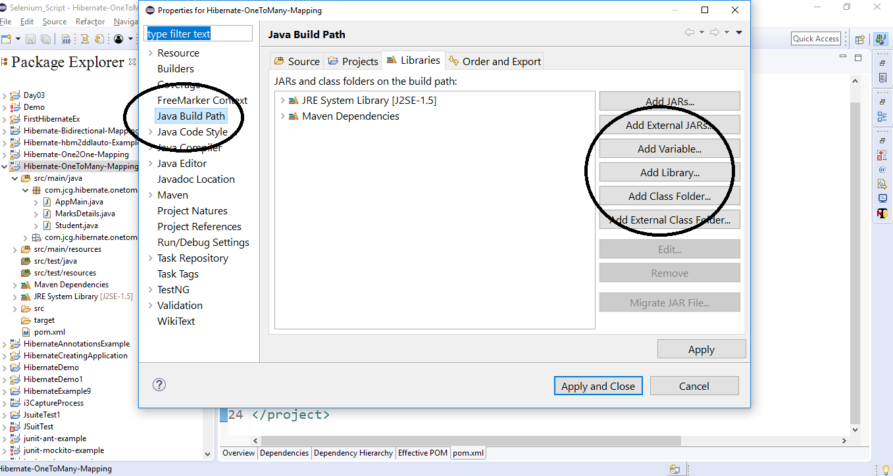
Cont..

Slide 50
Cont..
Pom.xml
<dependencies>
<!-- Hibernate 4.3.6 Final -->
<dependency>
<groupId>org.hibernate</groupId>
<artifactId>hibernate-core</artifactId>
<version>4.3.6.Final</version>
</dependency>
<!-- Mysql Connector -->
<dependency>
<groupId>mysql</groupId>
<artifactId>mysql-connector-java</artifactId>
<version>5.1.21</version>
</dependency>
</dependencies>
<build>
<finalName>${project.artifactId}</finalName>
</build>
</project>

Slide 51
Cont..
<?xml version='1.0' encoding='UTF-8'?>
<!DOCTYPE hibernate-configuration PUBLIC
"-//Hibernate/Hibernate Configuration DTD 3.0//EN"
"http://www.hibernate.org/dtd/hibernate-configuration-3.0.dtd">
<hibernate-configuration>
<session-factory>
<!-- SQL Dialect -->
<property name="hibernate.dialect">org.hibernate.dialect.MySQLDialect</property>
<!-- Database Connection Settings -->
<property name="hibernate.connection.driver_class">com.mysql.jdbc.Driver</property>
<property name="hibernate.connection.url">jdbc:mysql://localhost:3306/mapping</property>
<property name="hibernate.connection.username">root</property>
<property name="hibernate.connection.password">root</property>
<property name="show_sql">true</property>
<!-- Specifying Session Context -->
<property name="hibernate.current_session_context_class">org.hibernate.context.internal.ThreadLocalSessionContext</property>
<!-- Mapping With Model Class Containing Annotations -->
<mapping class="com.test.mapping.Student" />
<mapping class="com.test.mapping.MarksDetails" />
</session-factory>
</hibernate-configuration>

Slide 52
Cont..
public String getEmail() {
return email;
}
public void setEmail(String email) {
this.email = email;
}
public String getPhone() {
return phone;
}
@Column(name = "phone")
private String phone;
@OneToMany(mappedBy = "student", cascade = CascadeType.ALL)
private Set marksDetails;
public Student() { }
public Student(String firstName, String lastName, String email, String phone) {
this.firstName = firstName;
this.lastName = lastName;
this.phone = phone;
this.email = email;
}
public long getId() {
return id;
}
public void setPhone(String phone) {
this.phone = phone;
}
public Set getMarksDetails() {
return marksDetails;
}
public void setMarksDetails(Set marksDetails) {
this.marksDetails = marksDetails;
}}
package com.test.mapping;
import java.util.Set;
import javax.persistence.CascadeType;
import javax.persistence.Column;
import javax.persistence.Entity;
import javax.persistence.GeneratedValue;
import javax.persistence.Id;
import javax.persistence.OneToMany;
import javax.persistence.Table;
@Entity
@Table(name = "student")
public class Student {
@Column(name = "student_id")
private long id;
@Column(name = "first_name")
private String firstName;
@Column(name = "last_name")
private String lastName;
@Column(name = "email")
private String email;
public void setId(long id) {
this.id = id;
}
public String getFirstName() {
return firstName;
}
public void setFirstName(String firstName) {
this.firstName = firstName;
}
public String getLastName() {
return lastName;
}
public void setLastName(String lastName) {
this.lastName = lastName;
}

Slide 53
Cont..
package com.test.mapping;
import javax.persistence.Column;
import javax.persistence.Entity;
import javax.persistence.GeneratedValue;
import javax.persistence.Id;
import javax.persistence.JoinColumn;
import javax.persistence.ManyToOne;
import javax.persistence.Table;
@Entity
@Table(name = "marks_details")
public class MarksDetails {
@Id
@GeneratedValue
@Column(name = "test_id")
private long testId;
@Column(name = "subject")
private String subject;
@Column(name = "max_marks")
private String maxMarks;
@Column(name = "marks_obtained")
private String marksObtained;
@Column(name = "result")
private String result;
@ManyToOne
@JoinColumn(name = "student_id")
private Student student;
public MarksDetails() { }
public MarksDetails(String subject, String maxMarks, String marksObtained, String result) {
this.subject = subject;
this.maxMarks = maxMarks;
this.marksObtained = marksObtained;
this.result = result;
}
public long getTestId() { return testId;
}
public void setTestId(long testId) {
this.testId = testId;
}
public String getSubject() {
return subject;
}
public void setSubject(String subject) {
this.subject = subject;
}
public String getMaxMarks() {
return maxMarks;
}
public void setMaxMarks(String maxMarks) {
this.maxMarks = maxMarks;
}
public String getMarksObtained() {
return marksObtained;
}
public void setMarksObtained(String marksObtained) {
this.marksObtained = marksObtained;
}
public String getResult() {
return result; } contd…

Slide 54
Cont..
// Creating Hibernate SessionFactory Instance
sessionFactoryObj = configObj.buildSessionFactory(serviceRegistryObj);
return sessionFactoryObj;
}
public static void main(String[] args) {
System.out.println(".......Hibernate One To Many Mapping Example.......\n");
try {
sessionObj = buildSessionFactory().openSession();
sessionObj.beginTransaction();
Student studentObj = new Student(“Sushant", “Gandhi", “sushant2gmal.com", “990110009");
sessionObj.save(studentObj);
MarksDetails marksObj1 = new MarksDetails("English", "100", "90", "Pass");
marksObj1.setStudent(studentObj);
sessionObj.save(marksObj1);
MarksDetails marksObj2 = new MarksDetails("Maths", "100", "99", "Pass");
marksObj2.setStudent(studentObj);
sessionObj.save(marksObj2);
MarksDetails marksObj3 = new MarksDetails("Science", "100", "94", "Pass");
marksObj3.setStudent(studentObj);
sessionObj.save(marksObj3);
// Committing The Transactions To The Database
sessionObj.getTransaction().commit();
public void setResult(String result) {
this.result = result;
}
public Student getStudent() {
return student;
}
public void setStudent(Student student) {
this.student = student;
}
}
package com.test.main;
import org.hibernate.Session;
import org.hibernate.SessionFactory;
import org.hibernate.boot.registry.StandardServiceRegistryBuilder;
import org.hibernate.cfg.Configuration;
import org.hibernate.service.ServiceRegistry;
public class AppMain {
static Session sessionObj;
static SessionFactory sessionFactoryObj;
private static SessionFactory buildSessionFactory() {
// Creating Configuration Instance & Passing Hibernate Configuration File
Configuration configObj = new Configuration();
configObj.configure("hibernate.cfg.xml");
// Since Hibernate Version 4.x, ServiceRegistry Is Being Used
ServiceRegistry serviceRegistryObj = new StandardServiceRegistryBuilder().applySettings(configObj.getProperties()).build();

Slide 55
Contd…
System.out.println("\n.......Records Saved Successfully To The Database.......");
} catch(Exception sqlException) {
if(null != sessionObj.getTransaction()) {
System.out.println("\n.......Transaction Is Being Rolled Back.......");
sessionObj.getTransaction().rollback();
}
sqlException.printStackTrace();
} finally {
if(sessionObj != null) {
sessionObj.close();
}
}
}
}

Slide 56
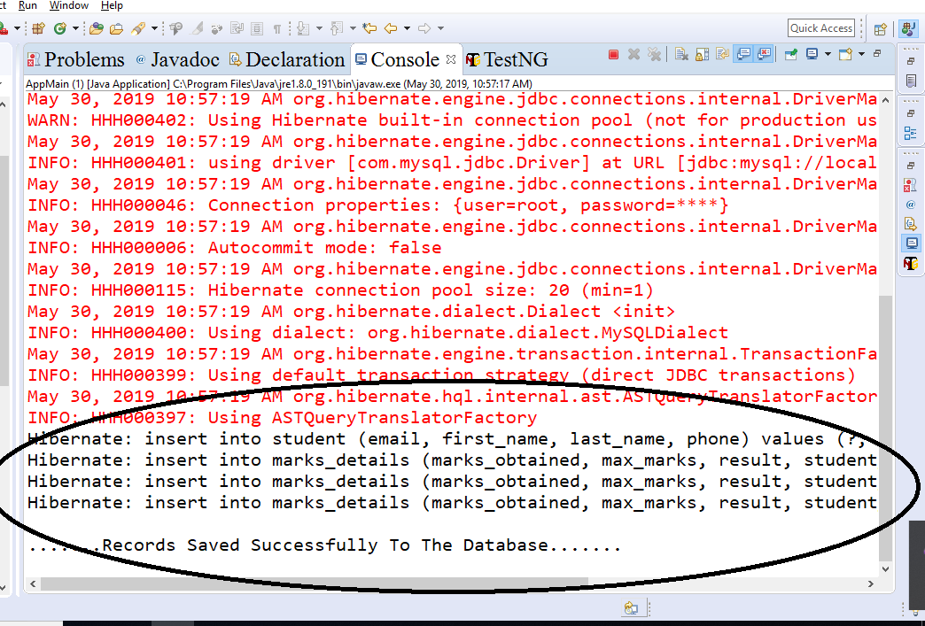
Cont..
Run The Project

Slide 57
Cont..
Step 8:
View Data In Database

Slide 58
MappedByProperty:
MappedByProperty:
MappedBy gives signal in hibernate for relationship.
It is object of entity of same class created in another class.
In one to one Perform at any side of mapping but perform at only one side . It will remove the extra column of foreign key constraint on the table on which class it is applied.
For example :
If we mapped by property in Employee class on employee object, then foreign key from Employee table will be removed.
You started with ManyToOne mapping , then you put OneToMany mapping as well for BiDirectional way.
Then at OneToMany , you must mention "mappedBy" (mapping is done by and in child table/class)
Notes:
Mapped by can be used only in one class because one table must contain foreign key constraint. if mapped by can be applied on both side then it remove foreign key from both table and without foreign key there is no relation b/w two tables.
it can be use for following annotations:- 1.@OneTone 2.@OneToMany 3.@ManyToMany
It cannot be use for following annotation :- 1.@ManyToOne

Slide 59
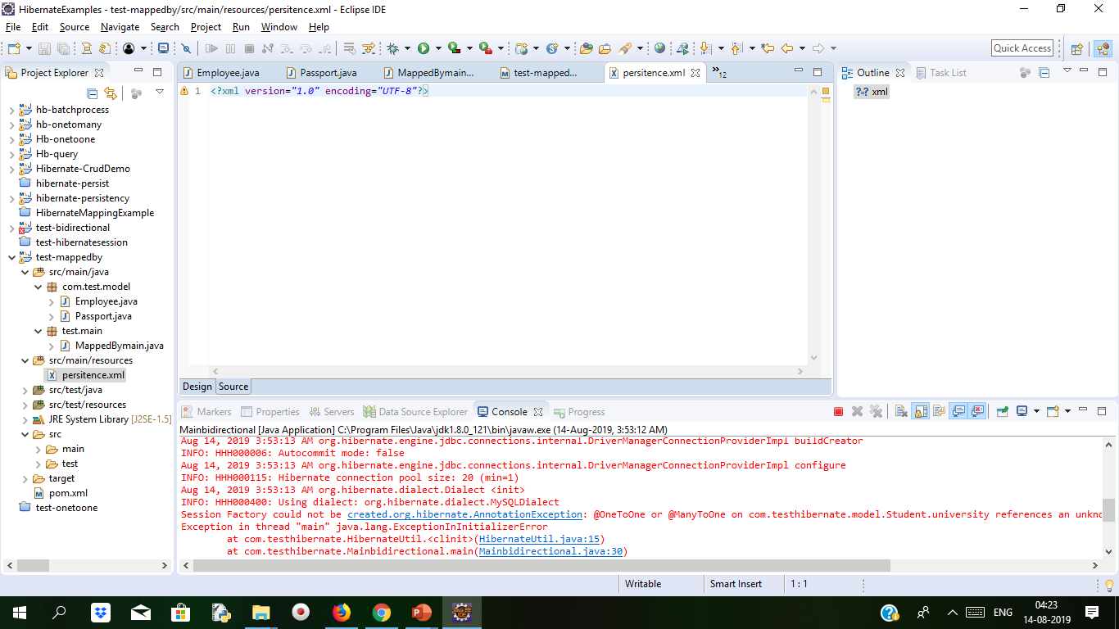
Demo: Mapping Duration 10min
Step 1:
Create Project With Suitable Name

Slide 60
Cont..
Step 2:
Add Dependency in POM.XML file
<dependencies>
<!-- https://mvnrepository.com/artifact/org.eclipse.persistence/eclipselink -->
<dependency>
<groupId>org.eclipse.persistence</groupId>
<artifactId>eclipselink</artifactId>
<version>2.5.2</version>
</dependency>
<dependency>
<groupId>org.eclipse.persistence</groupId>
<artifactId>javax.persistence</artifactId>
<version>2.0.0</version>
</dependency>
<!-- https://mvnrepository.com/artifact/mysql/mysql-connector-java -->
<dependency>
<groupId>mysql</groupId>
<artifactId>mysql-connector-java</artifactId>
<version>5.1.40</version>
</dependency>
<!-- https://mvnrepository.com/artifact/org.hibernate/hibernate-core -->
<dependency>
<groupId>org.hibernate</groupId>
<artifactId>hibernate-core</artifactId>
<version>5.2.11.Final</version>
</dependency>
<dependency>
<groupId>org.hibernate</groupId>
<artifactId>hibernate-entitymanager</artifactId>
<version>5.2.11.Final</version>
</dependency>
</dependencies>
<build>
<finalName>${project.artifactId}</finalName>
</build>
</project>

Slide 61
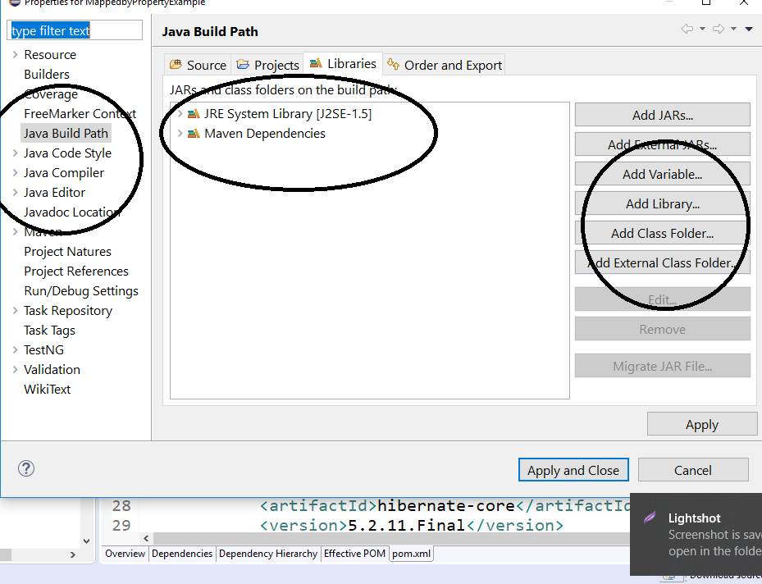
Cont..
Step 3:
Add User Library from build path

Slide 62
Cont..
Step 4:
Create Database,tables in MySQL
DROP DATABASE IF EXISTS mapping;
CREATE DATABASE IF NOT EXISTS mapping;
USE mapping;
CREATE TABLE EMPLOYEE_TABLE(
EMP_ID INT NOT NULL auto_increment,
EMP_NAME VARCHAR(50) NOT NULL,
PASSPORT_NUMBER INT NOT NULL,
PRIMARY KEY (EMP_ID)
);
CREATE TABLE PASSPORT_TABLE(
PASSPORT_NUMBER INT NOT NULL auto_increment,
ADDRESS_LINE1 VARCHAR(100) NOT NULL,
ADDRESS_LINE2 VARCHAR(100) NOT NULL,
STATE_NAME VARCHAR(50) NOT NULL,
COUNTRY_NAME VARCHAR(50) NOT NULL,
PRIMARY KEY (PASSPORT_NUMBER)
);

Slide 63
Cont..
Package test.model;
import java.io.Serializable;
import javax.persistence.CascadeType;
import javax.persistence.Column;
import javax.persistence.Entity;
import javax.persistence.FetchType;
import javax.persistence.GeneratedValue;
import javax.persistence.GenerationType;
import javax.persistence.Id;
import javax.persistence.JoinColumn;
import javax.persistence.OneToOne;
import javax.persistence.Table;
@Entity
@Table(name = "EMPLOYEE_TABLE")
public class Employee implements Serializable {
private static final long serialVersionUID = 1L;
@Id
@Column(name = "EMP_ID")
@GeneratedValue(strategy = GenerationType.IDENTITY)
private int employeeId;
@Column(name = "EMP_NAME")
private String name;
@OneToOne(fetch = FetchType.LAZY, cascade = CascadeType.ALL)
@JoinColumn(name = "PASSPORT_NUMBER")
private Passport passportDetails;
public Employee() { }
public int getEmployeeId() {
return employeeId;
}
public void setEmployeeId(int employeeId) {
this.employeeId = employeeId;
}
public String getName() {
return name;
}
public void setName(String name) {
this.name = name;
}
public Passport getPassportDetails() {
return passportDetails;
}
public void setPassportDetails(Passport passportDetails) {
this.passportDetails = passportDetails;
}
}

Slide 64
Cont..
Package test.model;
import java.io.Serializable;
import javax.persistence.Column;
import javax.persistence.Entity;
import javax.persistence.GeneratedValue;
import javax.persistence.GenerationType;
import javax.persistence.Id;
import javax.persistence.Table;
@Entity
@Table(name = "PASSPORT_TABLE")
public class Passport implements Serializable {
private static final long serialVersionUID = 1L;
@Id
@Column(name = "PASSPORT_NUMBER")
@GeneratedValue(strategy = GenerationType.IDENTITY)
private int passportNumber;
@Column(name = "ADDRESS_LINE1")
private String addressLine1;
@Column(name = "ADDRESS_LINE2")
private String addressLine2;
@Column(name = "STATE_NAME")
private String state;
@Column(name = "COUNTRY_NAME")
private String country;
public Passport() { }
public int getPassportNumber() {
return passportNumber;
}
public void setPassportNumber(int passportNumber) {
this.passportNumber = passportNumber;
}
public String getAddressLine1() {
return addressLine1;
}
public void setAddressLine1(String addressLine1) {
this.addressLine1 = addressLine1;
}
public String getAddressLine2() {
return addressLine2;
}
public void setAddressLine2(String addressLine2) {
this.addressLine2 = addressLine2;
}
public String getState() {
return state;
}
public void setState(String state) {
this.state = state;
}
public String getCountry() {
return country;
}
public void setCountry(String country) {
this.country = country;
}
}

Slide 65
Cont..
Now Configure in Persistance.xml file instead of Hbm.Confg.xml file
Persistance.XML file define one or more object-relation. Keep this file in resources folder
<?xml version="1.0" encoding="UTF-8"?>
<persistence version="2.1"
xmlns="http://xmlns.jcp.org/xml/ns/persistence" xmlns:xsi="http://www.w3.org/2001/XMLSchema-instance"
xsi:schemaLocation="http://xmlns.jcp.org/xml/ns/persistence http://xmlns.jcp.org/xml/ns/persistence/persistence_2_1.xsd">
<persistence-unit name=" mappedby " transaction-type="RESOURCE_LOCAL">
<class>com.test.model.Employee</class>
<class> com.test.model.Passport</class>
<!-- Configuring The Database Connection Details -->
<properties>
<property name="javax.persistence.jdbc.driver" value="com.mysql.jdbc.Driver" />
<property name="javax.persistence.jdbc.url" value="jdbc:mysql://localhost:3306/mapping" />
<property name="javax.persistence.jdbc.user" value="root" />
<property name="javax.persistence.jdbc.password" value=“root" />
</properties>
</persistence-unit>
</persistence>

Slide 66
Cont..
Main java file will map with persistence.xml file for configuration
import javax.persistence.EntityManager;
import javax.persistence.EntityManagerFactory;
import javax.persistence.Persistence;
public class MainApp {
private static final EntityManagerFactory emFactoryObj;
private static final String PERSISTENCE_UNIT_NAME = " mappedby ";
static {
emFactoryObj = Persistence.createEntityManagerFactory(PERSISTENCE_UNIT_NAME);
}
// This Method Is Used To Retrieve The 'EntityManager' Object
public static EntityManager getEntityManager() {
return emFactoryObj.createEntityManager();
}
private static void insertRecord() {
EntityManager entityMgrObj = getEntityManager();
if (null != entityMgrObj) {
entityMgrObj.getTransaction().begin();
Employee empObj = new Employee();
empObj.setName("Harry Potter");
Passport passportDetailsObj = new Passport();
passportDetailsObj.setAddressLine1("Cupboard Under D' Stairs");
passportDetailsObj.setAddressLine2(" 4 Privet Drive");
passportDetailsObj.setState("Little Whinging");
passportDetailsObj.setCountry("Surrey");
empObj.setPassportDetails(passportDetailsObj);
entityMgrObj.persist(empObj);
entityMgrObj.getTransaction().commit();
entityMgrObj.clear();
System.out.println("Record Successfully Inserted In The Database");
}
}
public static void main(String[] args) {
insertRecord();
}
}

Slide 67
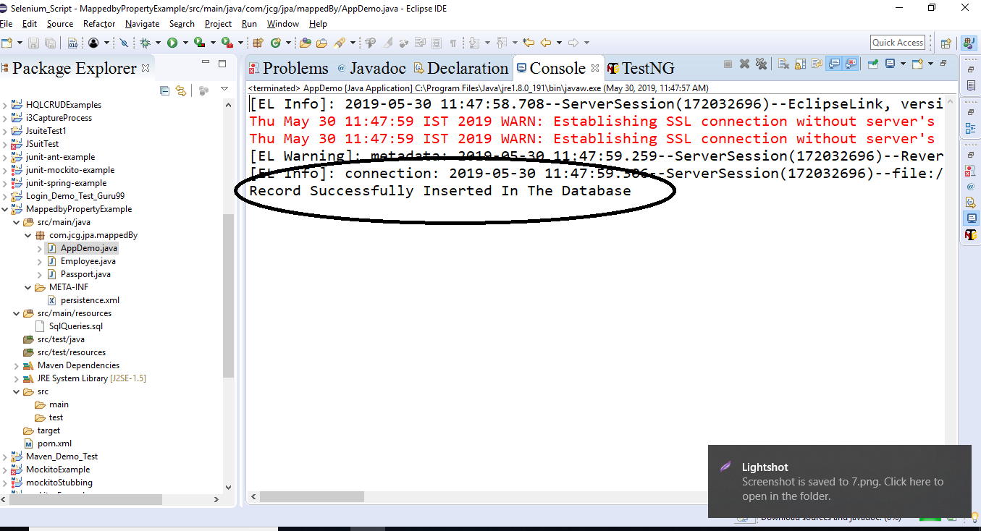
Cont..
Run The program

Slide 68
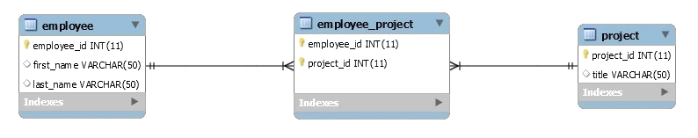
Many to Many Mapping
Many-TO-MANY mapping use the SET concept of collection.
A SET is mapped table data in <SET>
Employee can be assigned multiple to multiple projects and multiple employees.
It is implemented for database using JOIN table.
It is defined as multiple entities where one can have multiple relations.
One thing is important here is that when we used MANY-TO-MANY mapping in Hibernate it will generate two POJO objects

Slide 69
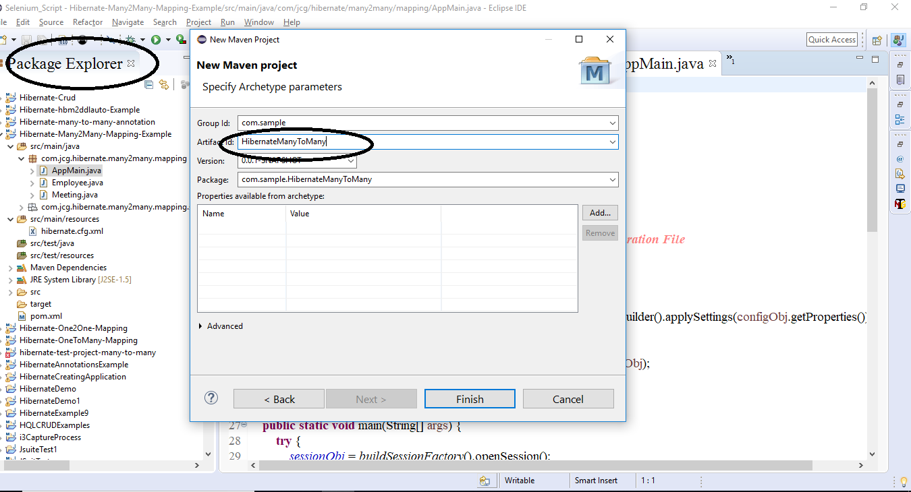
Demo: Many to Many mapping Duration: 15 min
Step 1:
Create Project With Suitable Name

Slide 70
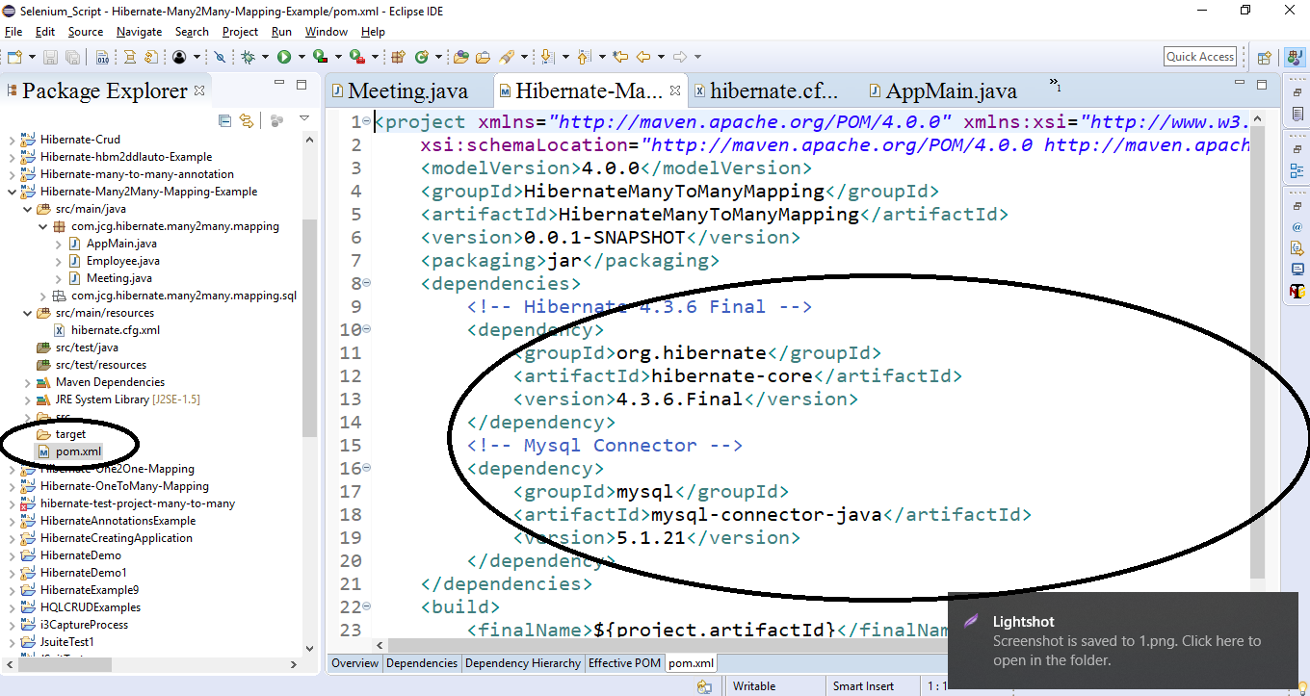
Demo: Many to Many mapping Cont..
Step 2:
Add dependency in POM.XML

Slide 71
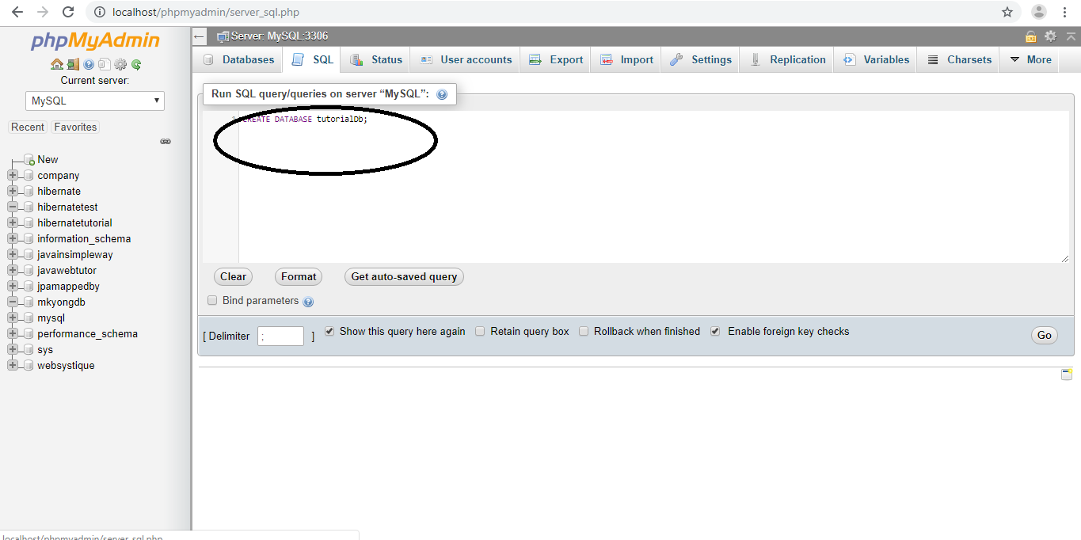
Demo: Many to Many mapping Cont..
Step 3:
Create Databse

Slide 72
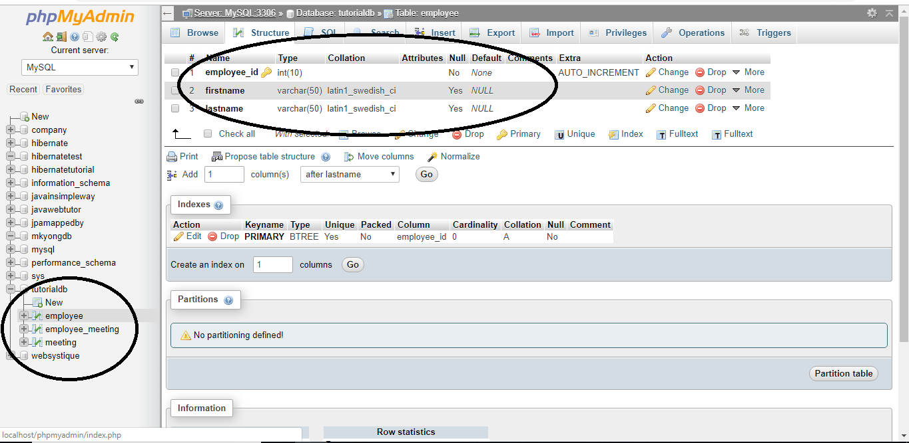
Demo: Many to Many mapping Cont..
Step 4:
Create Suitable Table

Slide 73
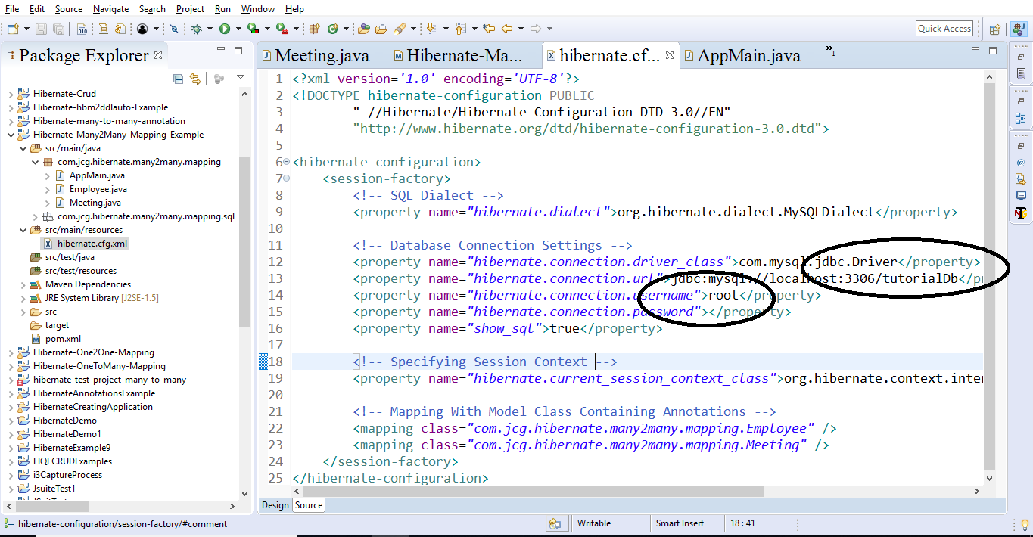
Demo: Many to Many mapping Cont..
Step 5:
Configure HBM.XML file and give database name

Slide 74
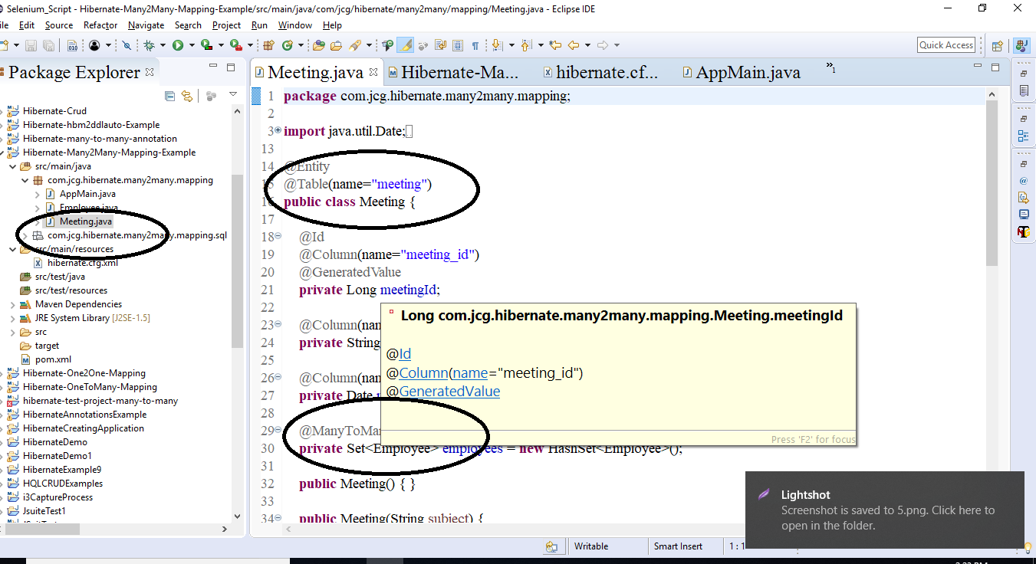
Demo: Many to Many mapping Cont..
Step 6:
Create POJO class with @ManytoMany annotation

Slide 75
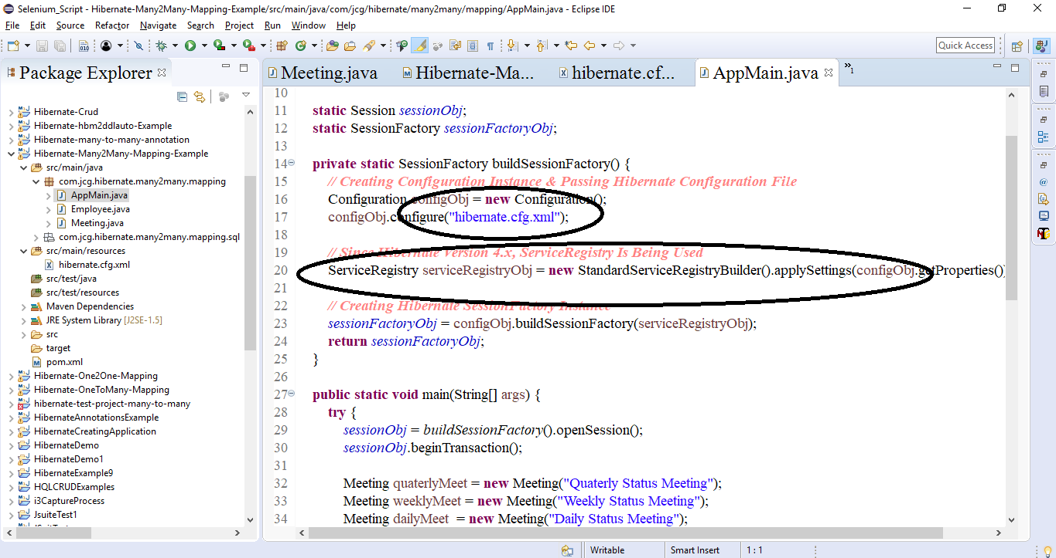
Demo: Many to Many mapping Cont..
Step 7:
Create Main Java class

Slide 76
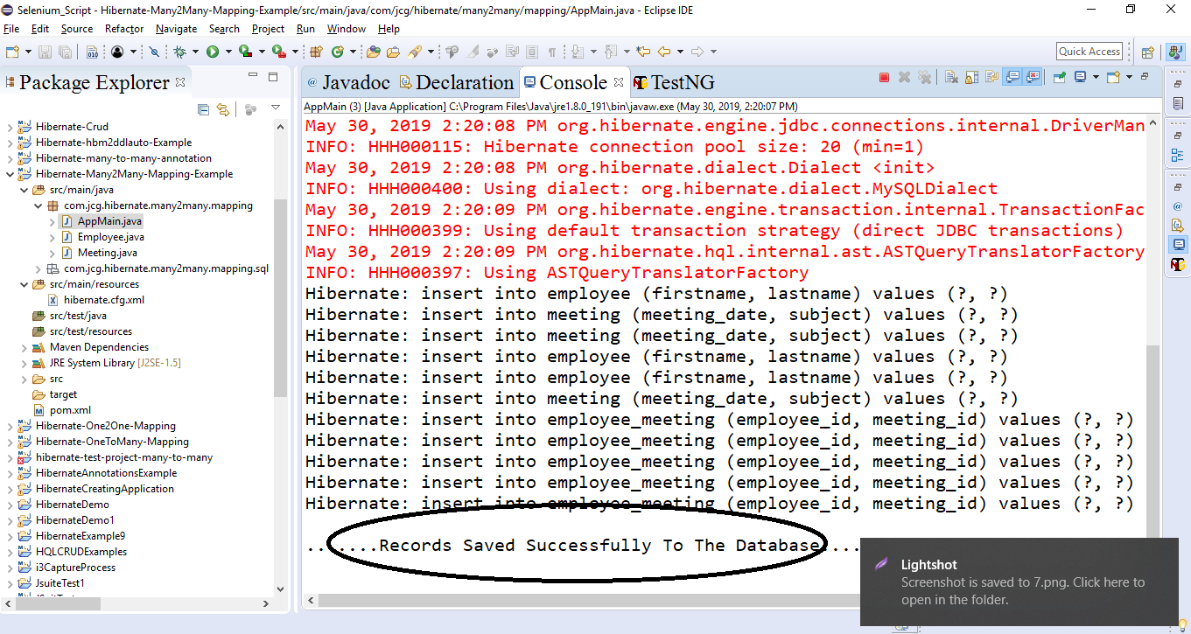
Demo: Many to Many mapping Cont..
Step 8:
Run the program

Slide 77
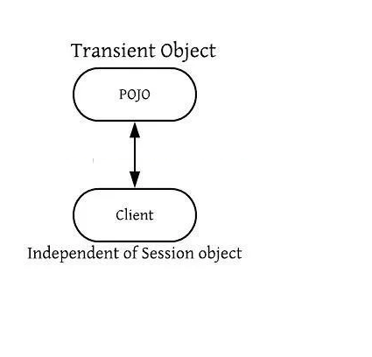
Hibernate Object State
It play important role in the execution of code in java.
It is also called life cycle of Hibernate.
It has three state:
1.Transient Object State
2.Persistent Object State
3.Detached Object State
1.Transient Object State

Slide 78
Hibernate Object State Cont..
An object which is not defined with session is called Transient Object State.
No Any Row defined in database is Transient Object State
It is Garbage Collector No Other Object Refer To It.
It is created with new() Operator.
When Object defined in Transient Object State there is no defined any identifier.
Example:
Customer cst = new Customer();
cst.setName(“Daniel Diaz");
// the object cst is in a transient state

Slide 79
OIR Mappings
So far, we learned about how to write our first hibernate application, there are two approach we have used for that
Using Annotation for Model Class Object Mapping
Another way Using Hibernate O/R Mapping file(.hbm.xml) for Model Class Object Mapping.
<?xml version=”1.0″?> <!DOCTYPE hibernate-mapping PUBLIC “-//Hibernate/Hibernate Mapping DTD 3.0//EN” “http://hibernate.sourceforge.net/hibernate-mapping-3.0.dtd”>
<hibernate-mapping> <class name=”com.test.hibernate.model.UserDetails” table=”UserDetails”> <id name=”userId” type=”long” column=”ID” > <generator class=”assigned”/> </id>
<property name=”userName”> <column name=”UserName” /> </property> </class> </hibernate-mapping>

Slide 80
Summary
In this Module, we have learnt the following:
What is Mapping
Persistent Class
Mapping Files
Mapping Types
OIR Mappings

Slide 81

Thank You

